Slide 1
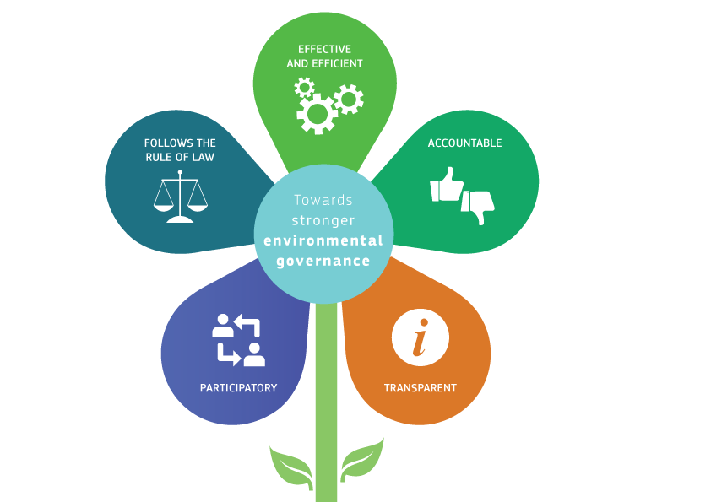
Fitness Check of environmental monitoring and reporting
(including link to INSPIRE)
European Commission
Directorate General for Environment
Unit D.4 – Governance, Information & Reporting
Notes:
1

Slide 2
The mandate
Better Regulation Communication: "Better Regulation for Better Results" (COM(2015)215)
  Launch a broad review of reporting requirements to see how burdens can be alleviated. This review will have a particularly strong focus on areas where stakeholders have recently indicated their concerns, such as agriculture, energy, environment and financial services.
  Cooperate with certain Member States which are examining the best ways to ensure compliance with EU law at national level and have initiated a review of how well EU and Member State regulation combines to help protect the environment (the 'Make It Work' initiative). The objective is to identify commonly used instruments and procedures across directives to see where duplication, varying definitions and terms can be reduced while maintaining the level of protection in the legislation and improving the efficiency of its application.
Commission Work Programme 2016 : "No time for business as usual" (COM(2015) 692)
  Annex II: Fitness Check to identify opportunities to simplify and alleviate reporting obligations stemming from EU environmental law with a view to develop a more modern, efficient and effective system for regulatory monitoring.
  Annex V: In 2016 the Commission intends to prepare a Communication (now Staff Working Document) which sets out the strategy and the ambition level of the Fitness Check of monitoring and reporting obligations in environment policy and documents some early actions in this field, among other things the state of play of the Standardised Reporting Directive and related questionnaires, including a possible proposal for its repeal.
Commission Roadmap
  See link:
http://ec.europa.eu/smart-regulation/
roadmaps/index_en.htm

Slide 3
The scope
Monitoring and Reporting of all environment legislation falling under DG ENV remit (some 55 pieces of legislation with approx. 170 reporting obligations)
Coherence to other policies and DGs (Inter-Service Group, Focus Group)
Link to other REFITs
  Energy/Clima Fitness Check
  ePRTR REFIT
  Many others
Contributes to Environment Implementation Review
Will address EEA regulation / EIONET dataflows
Assessment criteria:
Efficiency, effectiveness,
EU added value, relevance and coherence
Collaboration with other initiative (e.g. Make It Work)

Slide 4
Three areas of work
Area 3: the content
Area 2: the process
Area 1: the timing
Lower frequency of reporting
Better synchronisation
Efficiency gains through
automisation
harmonisation
centralisation
Less data requested
Ensure key performance Indicators
Less text more automised data

Slide 5
Fitness Check milestones
2015:
19/20 November: First Stakeholder Workshop (with Make It Work)
Public consultation
2016:
Commission Staff Working Document
Possible repeal of Standardised Reporting Directive (91/692/EEC)
Adoption of INSPIRE REFIT report
2017:
Fitness Check: Presentation of the results
Action list based on Fitness Check – start of implementation
Input for EEA evaluation

Slide 6
Preliminary results of the public consultation

Slide 7
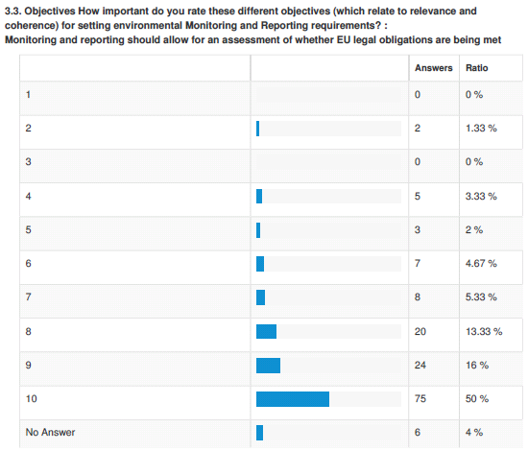
Top objectives and principles
Monitoring and reporting should...
Objectives
Allow for an assessment of whether EU legal obligations are being met;
Allow stakeholders to understand the environment and the actions taken to maintain and improve it;
Principles
Collect information once, minimise overlap and share it, where possible, for many purposes;
Result in information being fully available to the general public after due considerations of the appropriate level of aggregation and subject to the appropriate confidentiality constraints.
Better results on the ground
Facilitating Better Regulation in environment policy
Less pressure on public and private sector
Better information and empowerment of citizens

Slide 8
Preliminary results of the public consultation (IT/INSPIRE)

Slide 9
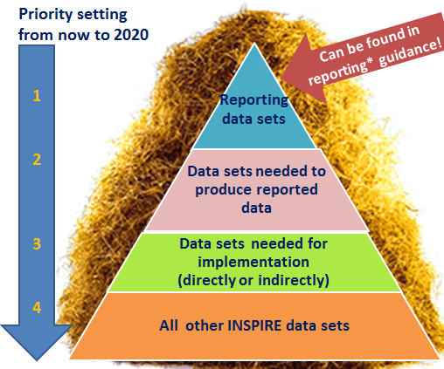
The INSPIRE Directive REFIT evaluation
Main findings:
Implementation is hetero-genious and lagging behind in most MS
Coordination btw INSPIRE and envReporting bodies sub-optimal
Limited end user applications (in particualr at EU level)
Current data policies hinder free flow of data
Mid-term review was done as REFIT evaluation
Next steps
Results to be published soon
Follow up discussions have already started

Slide 10
The importance of the INSPIRE Directive
Modernising IT for reporting with the help of INSPIRE will be essential
But…INSPIRE is (perceived) too complex
AND…REFIT evaluation has shown gaps
Hence, we want to
Make INSPIRE fit for purpose
Set priorities
Identify minimum list of data sets based on reporting
Focus on end-user needs

Slide 11
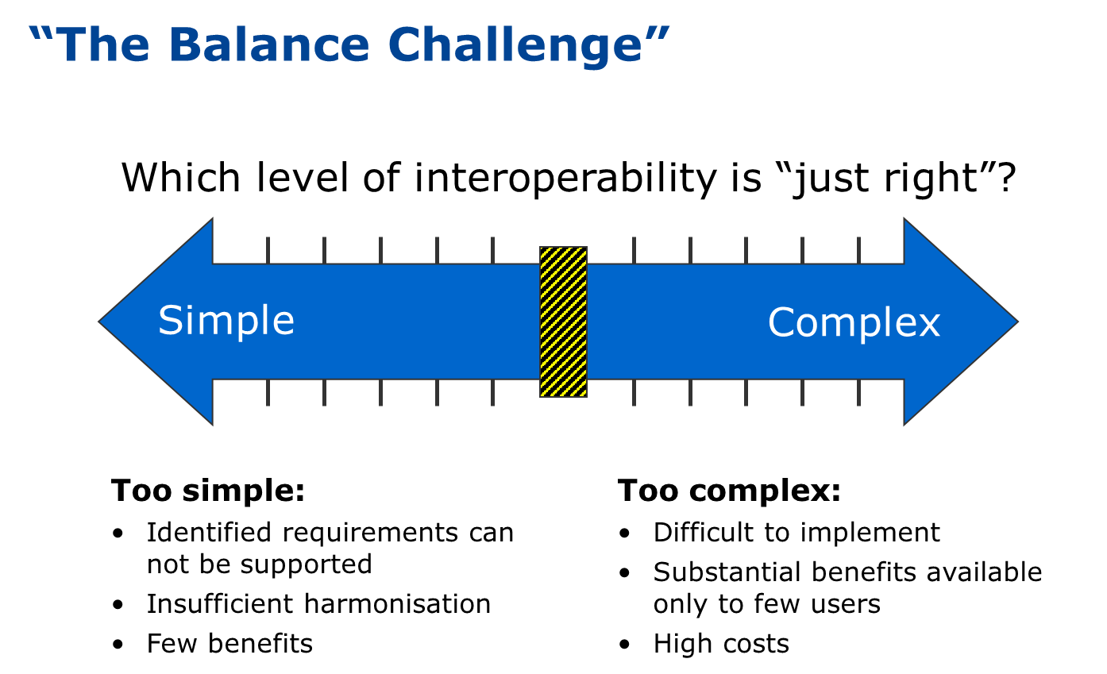
INSPIRE Directive

Slide 12
INSPIRE Directive –
consultations with MS
MIG-P orientation debate
Welcomed the opportunity to discuss the future orientation
Fully supported the need for priority setting
Acknowledged importance to enhance the efficiency of environmental reporting through INSPIRE
Identified a number of ideas and suggestions for future work
Bilaterals with MS
More progress than expected but INSPIRE not driving force for change
Linked to reporting stressed
Commitments to develop action plan
Dialogue and priority setting appreciated
Further discussions
Review with MIG lessons learnt from the MIF
Discuss and agree MIWP 2016-2020 in June

Slide 13

The INSPIRE Directive – future priorities: reporting
Priority setting
from now to 2020
Can be found in reporting* guidance!
Examples
Location of installations or monitoring stations, protected areas, water bodies, aggregated data etc.
Permits, emissions, monitoring results, etc.
Land-use, soils, river flow, modelling etc.
Road networks, cadaster
Reporting
data sets
Basic INSPIRE data sets
Data sets needed to produce reported data
Data sets needed for implementation
(directly or indirectly)
1
2
3
4
* Reporting Obligations Database EEA: see for UWWT http://rod.eionet.europa.eu/obligations/613

Slide 14
Conclusionss & next steps
Fitness Check is now starting – 2016 will prepare the evaluation with extensive consultations (e.g. two Stakeholder Workshops, INSPIRE Conference)
Overall coherence (also with ePRTR, IED, nature...) will be part of evaluation
Consequences for sectorial reporting too early to say
Priority setting and further work on INSPIRE will be crucial – discussions with Member States in June – get involved!
Issue of eReporting will be main subject at the INSPIRE Conference 2016 in Barcelona (26-30 Sept), Fitness Check Workshop may take place there.

Slide 15
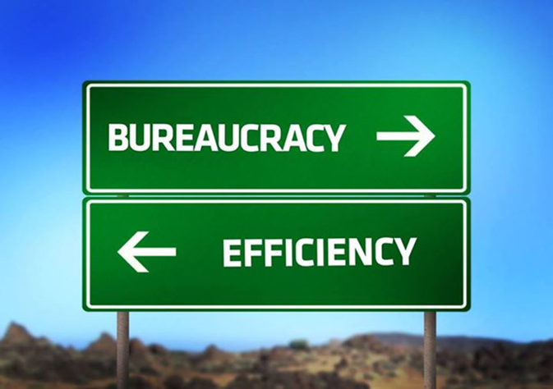
Questions?
Contacts:
Steve White (Unit ENV. F1) stephen.white@ec.europa.eu
Joachim D'Eugenio (Unit ENV D.4) joachim.d'eugenio@ec.europa.eu
Thank you for your attention
More information:
http://ec.europa.eu/environment/legal/reporting/index_en.htm

