Slide 1
Examination of MAC with R1234yf in
Motor Vehicles – major reflexions to the
JRC draft-report
Fahrzeugtechnik
3rd meeting of Expert group 24th January 2014 in Ispra
Kraftfahrt-Bundesamt
Vehicle Technology Department

Slide 2
Abstract of KBA understanding of major items
There is a consensous about the Level 1 and 2 tests
KBA understands the nature of Level 3 tests as realistic
Use cases and relevant test parameters have a non neglegtible probability
Additional GIDAS analysis by Bast delivers evidence
Detailed comments to be find in the word-doc statement!

Slide 3
Abstract of KBA understanding of major items
The scope of the scientific support of JRC is not broad enough.
Non clear understanding of the basic principles and occurence of an inflammation and
The formation and exposition of HF
leads to the necessity of further tests and research

Slide 4
Abstract of KBA understanding of major items
No minimum border temperature (700°C?)
KBA Tests also show lower temp HF creation
Other manufacturer tests also provide evidence of lower temp inflammations
December 2012 – Tests by VDA
Detailed comments to be find in the word-doc statement!

Slide 5
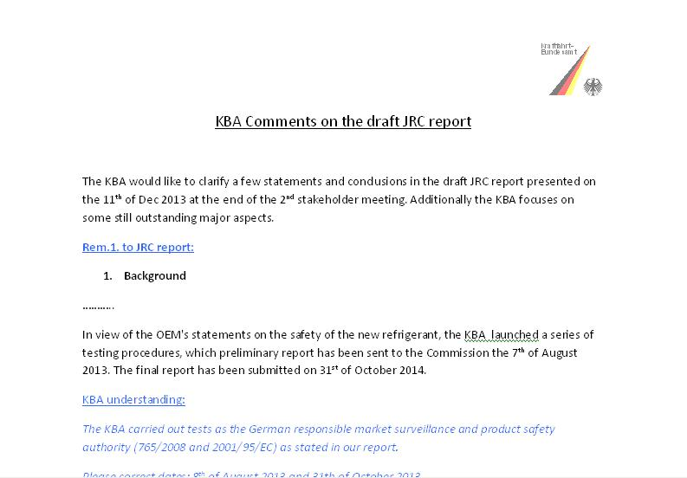
KBA statement to JRC draft report

Slide 6
Extended GIDAS analysis
New crash szenarios
Judgement and validation of Level 3 testing
Baffle plate scenario and
non leaking condenser

Slide 7
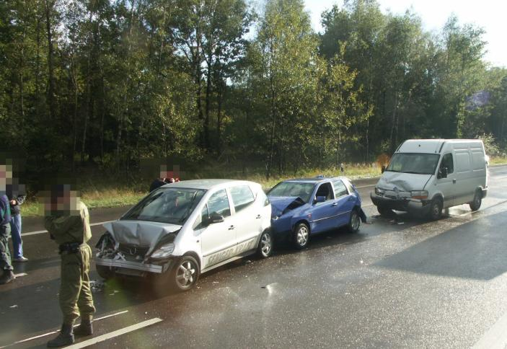
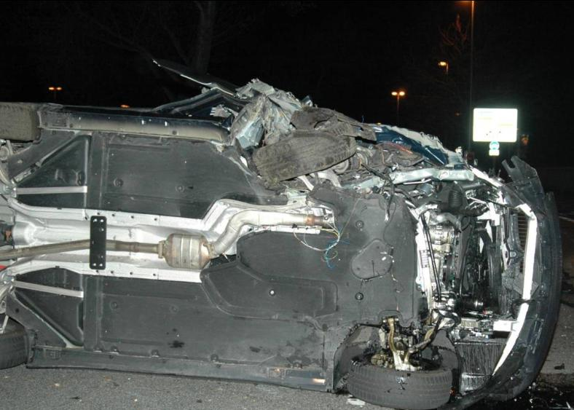
Extended GIDAS analysis real life pictures
Baffle plate scenario
motorway multiple-crash
non leaking condenser
Side / low overlap offset

Slide 8
Impressum
Herausgeber:
Kraftfahrt-Bundesamt
24932 Flensburg
Internet: www.kba.de
Fachliche Auskünfte und Beratung:
Telefon: 0461 316-0
Telefax: 0461 316-1650
E-Mail: kba@kba.de
Stand: November 2013
Druck: Druckzentrum KBA
Bildquelle: xxxxx
Alle Rechte vorbehalten. Die Vervielfältigung und Verbreitung dieser Veröffentlichung, auch auszugsweise und in digitaler Form, ist nur mit Quellenangabe gestattet. Dies gilt auch, wenn Inhalte dieser Veröffentlichung weiterverbreitet werden, die nur mittelbar erlangt wurden.
© Kraftfahrt-Bundesamt, Flensburg
KBA - Wir punkten mit Verkehrssicherheit

