Slide 1
UWW SIIF in Ireland

Slide 2
Current Situation in Ireland
UWW data collection is well managed
  Monitoring data is uploaded in .xml format to Monitoring Data System hosted in the Environmental Data Exchange Network
We have implemented a new UWW licensing regime and have developed IT systems to support this(LEMA)
  Work is still ongoing on this, but we get a lot of data via this system, particularly with regard to licence non compliances and incidents.
We are working in the licensing process to look at Programmes of Improvements and the best ways to report on these.
We put all information relating to the permitting of UWW plants on the web site (in PDF).

Slide 3
The work on UWW is being closely linked to what we are doing on WFD.
We publish an Urban Waste Water report every 2 years and also issue updated to this report. There a lot of detail in the Annexes on plant performance, reasons for failure and improvement programmes required.
We are now working to make this data available as a more interactive website that will deliver SIIF requirements. This data for the site will be populated either from a Data Warehouse (in development) or via our DREAM web-service.

Slide 4
WISE
WFD
UWW
DW
BW
GW
PRTR
LA LIMS
LA LIMS
EDEN Portal
Monitoring Data Exchange
Urban Waste Water
Drinking Water Management
Bathing Water Management
River Basin Management
Monitoring Data Exchange
LA Other Systems
LA Other Systems
CRM &
Aquarius
River Water
Drinking Water
Bathing Water
C&T
Lakes
Ground Water
UWW
DEHLG
BW
HSE
Marine
Institute
Fisheries
Bathing Water
Bathing Water Management
LIMS
An Taisce
An Taisce
GIS
Internet
Complaints
Licence Search
GIS
Submissions
Water Quality
SPLASH
LEMA
Licencing (UWW, IPPC)
Complaints Management
Incident Management
River Basin Management
Compliance Checking
Risk Assessment
Public
Finance
Complainants
Stakeholders
SPLASH
Incident Management

Slide 5
LEMA - Scope
To develop a new, end-to-end licensing, enforcement, monitoring and reporting application (LEMA).
To employ contemporary ICT and GIS technologies to enhance the work procedures of Agency staff through the elimination of duplication, reduction of reliance on manual procedures and promotion of strategic practices.
Notes:
It is end-to-end, meaning it will cover all requirements including
receipt of the application, licence appraisal, assessment of ongoing monitoring, evaluation of compliance details and reporting of information to third parties.
It will involve the upgrade of Agency systems to use up to date Industry Standard technologies and
Aims to enhance the work of staff throughout the Agency.
It is in its third year of development and has ~100 Agency users, and 1000 external users.

Slide 6


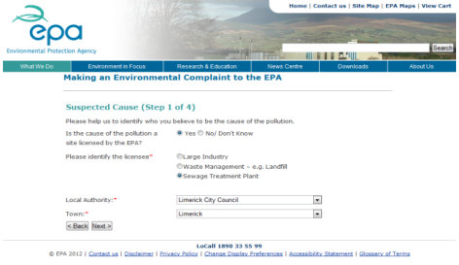
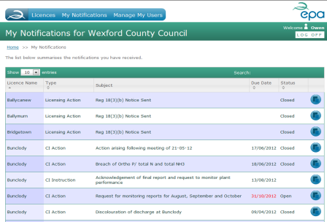
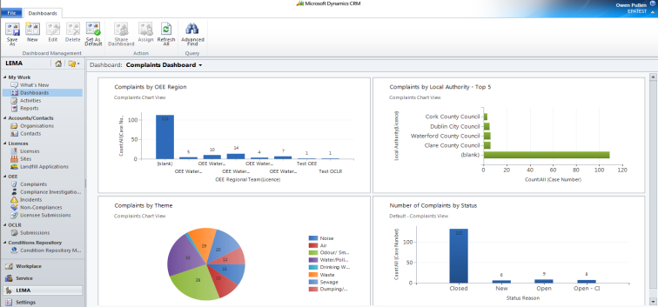

One data set, three perspectives
Members of the public
Licensees
EPA.IE
EDEN /
ALDER
Portal
LEMA
Platform
EPA Staff

Slide 7
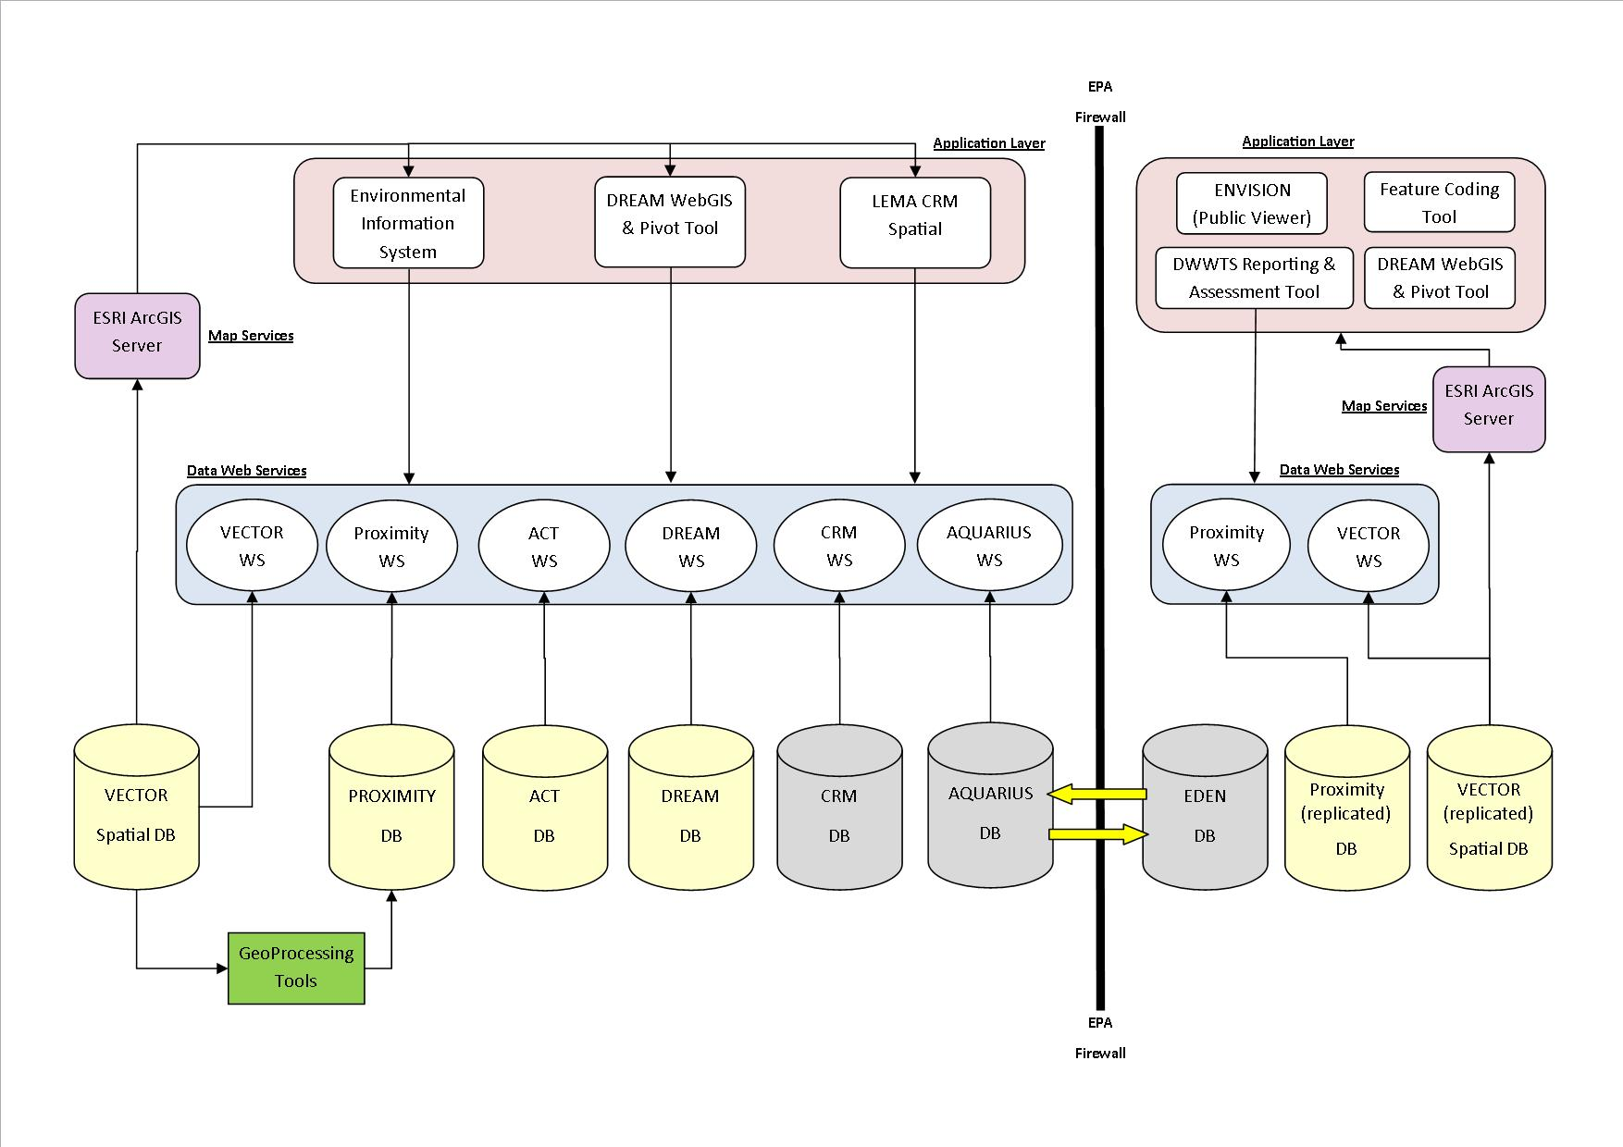
DREAM – The Method

Slide 8
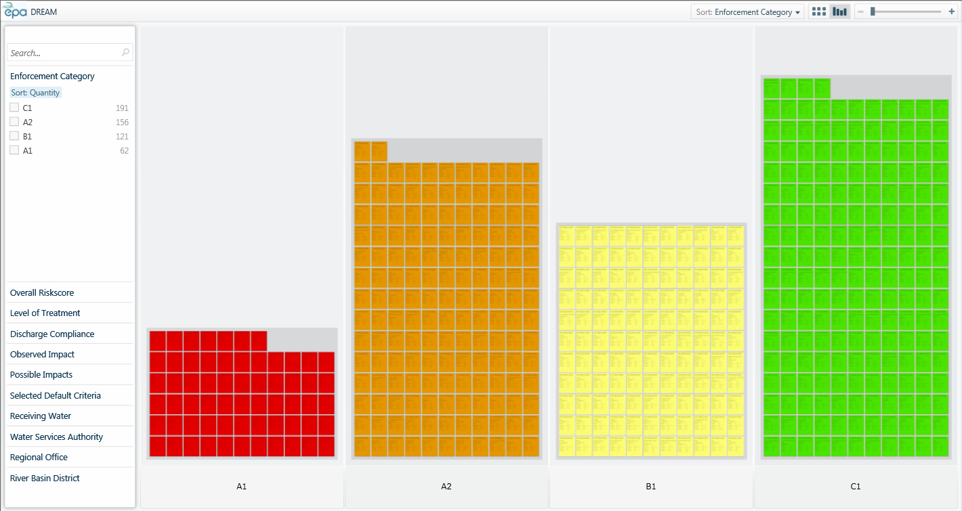
DREAM Web Service – Output

Slide 9
There are Challenges
The Change Dilemma
Status Quo
Existing Legislation
Existing Org. Structures
WFD
Resource Constraints
Existing Budget Structure
Integrated Catchment Approach
Existing Reporting
Blueprint
Pain of Change

