Slide 1


ESS Vision 2020 Implementation

Slide 2
Presentation Outline:
To present progress on the elaboration of the ESS Vision 2020 portfolio made since November ESSC;
Describe the prioritisation exercise conducted by VIG;
Present the revised ESS Vision 2020 portfolio;
Outline the next steps with the implementation of the ESS Vision 2020.

Slide 3
Activity since November ESSC
November ESSC
  Welcomed PG TF work on Vision implementation
  More prioritisation & discussion of strategic risks needed
  Agreed SIMSTAT REDESIGN project
  Agreed to conclude PG TF and activate VIG/VIN
Eurostat Portfolio Management Bureau established
  Eurostat/UK exchange visits on portfolio management
VIG activated
  Eurostat (chair), Belgium, France, Hungary, Italy, Netherlands, Norway, Sweden, Slovenia, UK (deputy chair)
  1st VIG meeting 20 Jan 2015 (rules of procedure, portfolio information pack, portfolio prioritisation, roadmap, ESSC seminar preparation)
VIN members appointed

Slide 4
Prioritisation started from the list of potential VIPs discussed in Nov ESSC
In total 15 projects :
Original eight + seven floated in Nov ESSC
SIMSTAT
ESBRs
VALIDATION
ADMIN
IMS
ESDEN
SERV
DW
REDESIGN
DIGICOM
UA/IPROD
BIGD
DARA
QUAL
SUPP

Slide 5
VIG scoring exercise
Used tailored version of Options Analyser Tool – developed by UK academics, underpinned by research into why projects fail
VIG member assessments of projects by their:
  Attractiveness
    Contribution to 5 strategic areas of Vision
    Benefits (costs reduction, quality improvement, burden reduction)
    Architectural fit
    Product enhancement potential
  Achievability
    Degree of challenge
    Capability to deliver
  Affordability
    Project costs in EC
    Project costs in NSIs
    Deployment costs in NSIs

Slide 6
Strategic Contribution – Original Portfolio (pre PGTF)

Slide 7
Example plots – attractiveness vs achievability

Slide 11
But what do the country variations tell us?

Slide 12
EUROSTAT
UK

Slide 13
And if we plot
all potential VIPs ....

Slide 14
Portfolio Attractiveness by Achievability
DISTRACTION?
COMMIT
DROP?
CAPABILITY?

Slide 15
A guide – not the answer
Helps us ask the right questions
Combine with views/other evidence

Slide 16
Revised ESS Vision 2020 Portfolio

Slide 17
ESS Vision 2020 Portfolio as presented in Nov ESSC
New
BIGD
On-going
Available business cases
SIMSTAT
ADMIN
DARA
DIGICOM
REDESIGN
ESDEN
IMS
UA/IPROD
ESBRs
SERV
DW
QUAL
VALIDATION
SUPP

Slide 18
Revised ESS Vision 2020 portfolio
New
BIGD
On-going
Available business cases
SIMSTAT
ADMIN
DARA
DIGICOM
REDESIGN
ESDEN
IMS
UA/IPROD
ESBRs
SERV
DW
QUAL
VALIDATION
SUPP
ESS Vision 2020 portfolio of 8 projects

Slide 19
Revised ESS Vision 2020 portfolio
New
BIGD
On-going
Mature
SIMSTAT
ADMIN
DARA
DIGICOM
REDESIGN
UA/IPROD
ESDEN
IMS
ESBRs
SERV
DW
QUAL
VALIDATION
Support
ESS.VIPs
SUPP

Slide 20
Strategic Contribution of Original Portfolio to the Five Key Vision Areas

Slide 21
Strategic Contribution of Revised Portfolio to the Five Key Vision Areas

Slide 22
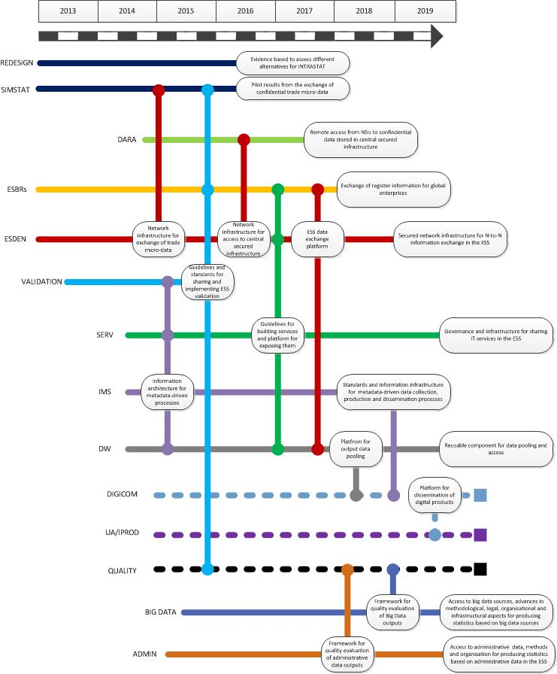
Portfolio achievability

Slide 23
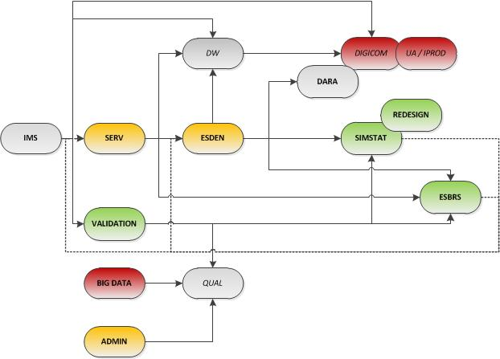
Projects dependencies

Slide 24
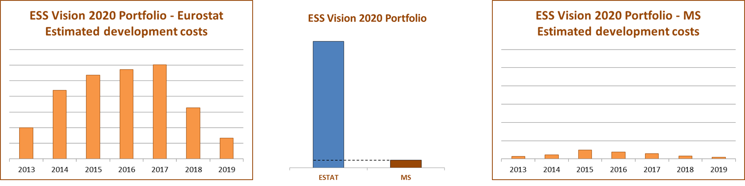
Portfolio affordability
Total estimated development cost | Eurostat | Member States
 | 56.2 M€ (estimate) of which 22.3 M€ given to MS for co-financing (estimate) | 3.5 M€ (estimate)
Please note: no deployment costs included

Slide 25
Portfolio outcomes one 1 year later
Results from pilot exchange of microdata in internal trade of goods from SIMSTAT and evidence based assessment of variants for REDESIGN of INTRASTAT;
Available interoperability framework for ESBRs;
Inventory and registry of validation rules across ESS;
Available IT infrastructure for secure data exchange among ESS partners by ESDEN;
Catalogue of business services with potential to be shared, pilot tests for ESBRs and validation services, guidelines and proposal for governance of shared services in ESS;
Progress with improved access and methods use and assess quality to administrative data;
Launch of 3 pilots on using Big data;
Launching of digital communication and user analytics project.

Slide 26

The portfolio minibus
ESS Vision 2020
SIMSTAT
BIGD
ADMIN
FRAMEWORKS
REDESIGN
ESSC
DIGICOM
ESDEN
VALIDATION
UA/IPROD
SERV
ESBRs

Slide 27
Modernisation of the ESS
ESS Vision 2020
SIMSTAT
BIGD
ADMIN
FRAMEWORKS
REDESIGN
ESSC
DIGICOM
ESDEN
VALIDATION
UA/IPROD
SERV
ESBRs

Slide 28
Modernisation of the ESS
ESS Vision 2020
ESSC
FRIBS
Social Statistics
Agricultural Statistics
Modernisation
Programmes
FRIBS
Social Statistics
Agricultural Statistics

Slide 29
Modernisation of the ESS
ESS Vision 2020
FRAMEWORKS
ESSC
FRIBS
Social Statistics
Agricultural Statistics

Slide 30
Next Steps

Slide 31
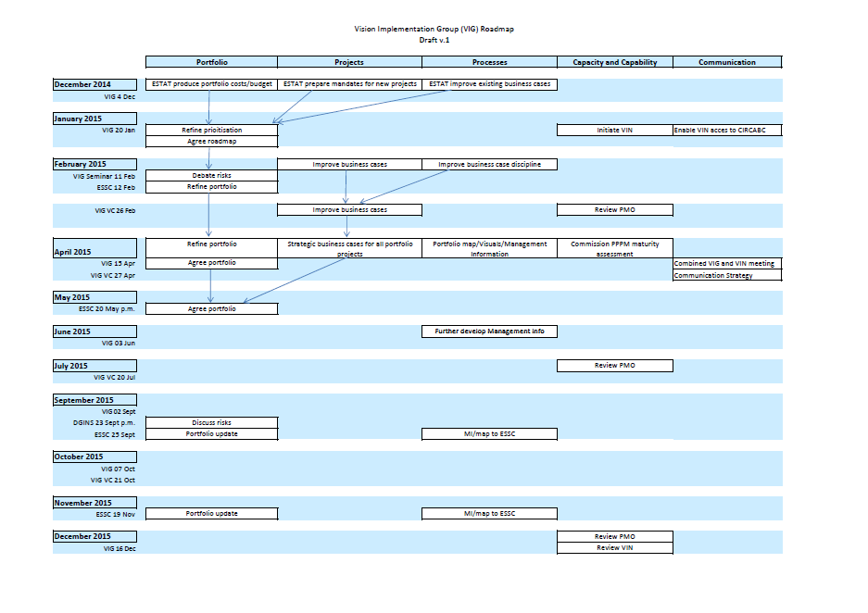

VIG Roadmap
Shows the VIG’s high level thinking/plan
Strategic communication document for the VIG/VIN
Five themes: Portfolio, Projects, Processes, Capability, Communication
Living document

Slide 32
Next steps: Portfolio and Projects
Portfolio
Further prioritisation with the involvement of VIN;
Prepare ground for May ESSC;
Develop management of strategic risks;
Consider role beyond VIPs;
Projects
Develop business cases for potential new VIPs;
Scrutinise/improve business cases for existing ones;
Develop /incorporate better cost estimates
  - Projects costs compared to available funding
  - Deployment intentions and costs in NSIs

Slide 33
Next steps: Processes
Portfolio management processes
Develop better management information on project status (eg delivery confidence, risks)
Improve business case process (more clarity on phases, approvals, content)
Portfolio Management Capability
Develop portfolio management capability in Eurostat, and in VIG/VIN
Assess ESS Project/Programme/Portfolio management maturity ?

Slide 34
Next steps: Communication
Promote Vision and implementation in NSIs, using VIG/VIN;
Develop communication tools, project summaries, portfolio map etc;
Combined VIG/VIN event.

Slide 35
What is expected from the workshop?
Take note of the progress made in establishing the ESS Vision 2020 portfolio;
Discuss and provide opinion on the revised proposal for the ESS Vision 2020 portfolio;
Give strategic guidance on further necessary adaptations to the projects in the ESS Vision 2020 portfolio;
Indicate possible elements of interest with regard to quality, user analytics and dissemination;
Provide opinion on the next steps.

Slide 36
Thank you for your attention!

