Slide 1
Modernisation Activities
DIME-ITDG – February 2015
Item 7

Slide 2
High Level Group for the Modernisation of Statistical Production and Services (HLG)
Set up by the Bureau of the Conference of European Statisticians in 2010
To oversee and coordinate international work relating to statistical modernisation
It promotes standards-based modernisation of statistical production and services
It reports directly to the Conference of European Statisticians and received its mandate from this body

Slide 3










… and what about statistics?
Who?
  10 heads of national and international statistical organisations

Slide 4
Mission
The mission of the HLG is
to oversee development of frameworks, and sharing of information, tools and methods, which support the modernisation of statistical organizations
The aim is to improve the efficiency of the statistical production process, and the ability to produce outputs that better meet user needs.

Slide 5
Objectives
To promote common standards, models, tools and methods to support the modernisation of official statistics
To drive new developments in the production, organisation and products of official statistics, ensuring effective coordination and information sharing within official statistics, and with relevant external bodies
To advise the Bureau of the CES on the direction of strategic developments in the modernisation of official statistics, and ensure that there is a maximum of convergence and coordination within the statistical "industry"

Slide 6
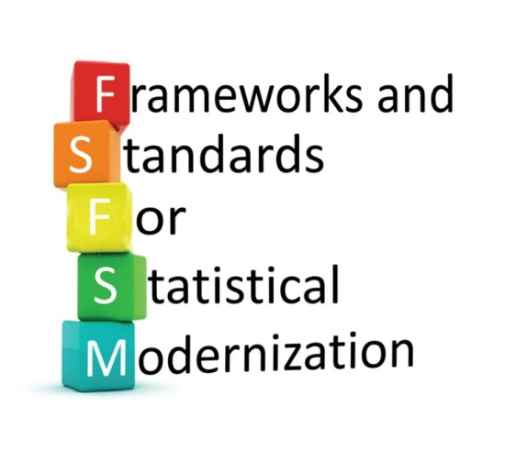
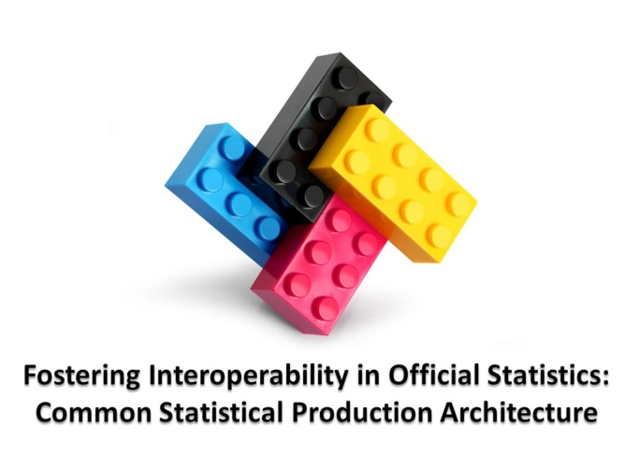
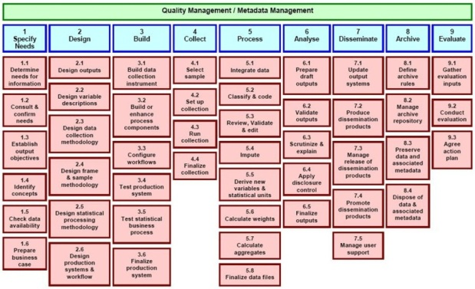



Standards-based Modernisaton
CSPA
Data Documentation Initiative
GSBPM

Slide 7
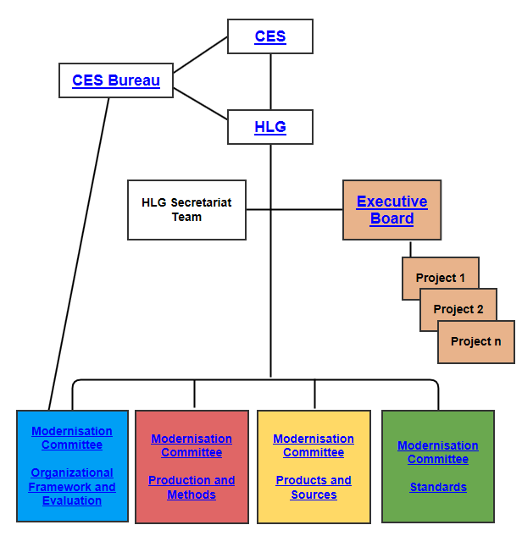
HLG organisation and projects
In 2014
Big Data
CSPA
In 2015
CSPA consolidation
Big Data

Slide 8
HLG initiatives – CSPA services 2014
Service | Organisations
Confidentialized analysis of microdata | Australian Bureau of Statistics Statistics Canada
Error correction | Istat
Linear error localisation | Statistics Netherlands
Linear rule checking | Statistics Netherlands
List statistical classifications | Statistics Norway
Retrieve statistical classification | Statistics Norway
Sample selection | Statistics Netherlands
SDMX transform | OECD
Seasonal adjustment | Australian Bureau of Statistics INSEE Statistics New Zealand
Statistical chart generator | OECD
Service catalogue – design, usage, definition of services, certification | UNECE -> Eurostat

Slide 9
HLG initiatives and ESS Vision 2020
Same approach to modernisation of statistical production processes
Need to streamline the input from the ESS to the HLG initiative and to strengthen the cooperation
Global standards – governance for endorsement and maintenance
CSPA successful approach but need to set up the infrastructure
EU HLG members input
Challenges for 2015
  Consolidation CSPA
  Pilot projects for Big Data
  Innovation

Slide 10
HLG and ESS: common areas of interest
Big Data – within UN Global Working Group initiative
SOA –Eurostat hosting catalogue of CSPA services
Standards –ESS contribution to developments in SDMX, CSPA, GSBPM, GSIM and DDI
Enterprise architecture
Organisational frameworks
GAMSO (Generic Activity Model for Statistical Organisations) – the equivalent to the ESS Vision 2020 GEMS (Generic Enterprise Model for Statistics)

Slide 11
Need for coordination HLG and ESS
Global standards – governance for endorsement and maintenance
Need to streamline the input from the ESS to the HLG initiative and to strengthen the cooperation
Increasing awareness and usage of CSPA
EU HLG members input to the work of the HLG
Pilot projects for Big Data
Innovation

Slide 12
2015 priority tasks
Regular work of the modernisation committees
Big Data continuation – proof of concept
CSPA continuation – operational – priorities
Mobile devices
Communication

Slide 13
Next events
Dates | Event
23-27 February | Information Architecture Sprint - Ottawa
1 March | HLG meeting
4 March | UNSC: HLG dedicated event
9 March | NTTS 2015 satellite event UNECE/HLG project on Big data
16-20 March | CSPA Investment Sprint
15-17 April | Workshop on the Modernisation of Statistical Production
5-7 May | Workshop on International Collaboration for Standards-Based Modernisation
16 June | CES 2015 Seminar – Modernisation of Statistical Production and Services and Managing for Efficiency

Slide 14
Thank you for your attention!

