Slide 1

UWWTD NATIONAL SIIF PILOT EXERCISE IN CYPRUS
MINISTRY OF AGRICULTURE , NATURAL RESOURCES AND ENVIRONMENT
Current Status
Alexia Panayi
Engineering Technician
Water Development Department
Ministry of Agriculture Natural Resources and Environment

Slide 2
Contents
Current Situation of urban wastewater data collection and data management
Current status and follow-up actions towards national UWWTD SIIF
  SIIF Excel Template Parameters on National Level
  Current CY GIS-system on National Level
Concluding Remarks

Slide 3
Current Situation of urban wastewater data collection and data management
Responsibilities for urban wastewater data collection and data management
  Ministry of Agriculture, Natural Resources and Environment with its two Departments
        Department of Environment (DE)
        Water Development Department (WDD)
  Sewerage Boards

Slide 4
Current Situation of urban wastewater data collection and data management
Data Collection and Data Management
  There are several national and regional Water Information Systems related to urban wastewater data in place in Cyprus.
  Specifically there are websites available from eight regions (=Sewerage Boards) and two national departments (WDD & DE).
    The websites are not connected to each other.
    The information is scattered between the websites and not homogenous for all agglomerations and UWWTPs.

Slide 5
Current Situation of urban wastewater data collection and data management
A best practice example for a national UWWTD SIIF element
    The following tabular form, which shows regularly updated data regarding the progress of the design, tendering and construction works of the National Implementation Program (NIP) Sewage Schemes, can be regarded as a best practice example for a national UWWTD SIIF element.
    Same data are kept in a map form, which are updated regularly as well.

Slide 6
UPDATED CONSTRUCTION TIMESCHEDULE FOR THE NATIONAL IMPLEMENTATION PROGRAMME OF THE UWWTD 91/271/ΕEC COMPARED TO NIP 2008
Date : October 2013 |  |  |  |  |  |  |  |  |  |  |  |  |  |  |  |  |  |  |  |  |  |  |  |  |  |  |  |  |  |  |  |  |  |  |  |  |  |  |  |  |  |  |  |  |  |  |  | Compliance with the UWWTD |  |  |  |  |  |  |  |  |  |  |  |  |  |  |  |  |  |  |  |  |  | Today
Complex No. | Agglo. ID | Project Description / Implemeting Authority | Size of Project | Construction Year |  | Duration (months) | 2008 |  |  |  | 2009 |  |  |  |  |  |  |  |  |  |  |  |  | 2010 |  |  |  |  |  |  |  |  |  |  |  | 2011 |  |  |  |  |  |  |  |  |  |  |  | 2012 |  |  |  |  |  |  |  |  |  |  |  | 2013 |  |  |  |  |  |  |  |  |  |  |  | 2014 |  |  |  |  |  |  |  |  |  |  |  | 2015 |  |  |  |  |  |  |  |  |  |  |  | 2016 |  |  |  |  |  |  |  |  |  |  |  | 2017 |  |  |  |  |  |  |  |  |  |  |  | 2018 |  |  |  |  |  |  |  |  |  |  |  | 2019 |  |  |  |  |  |  |  |  |  |  |  | 2020
 |  |  | % completed as at 30/9/2013 | Start | End |  | 1 | 2 | 3 | 4 | 1 |  |  | 2 |  |  | 3 |  |  | 4 |  |  |  | 1 |  |  | 2 |  |  | 3 |  |  | 4 |  |  | 1 |  |  | 2 |  |  | 3 |  |  | 4 |  |  | 1 |  |  | 2 |  |  | 3 |  |  | 4 |  |  | 1 |  |  | 2 |  |  | 3 |  |  | 4 |  |  | 1 |  |  | 2 |  |  | 3 |  |  | 4 |  |  | 1 |  |  | 2 |  |  | 3 |  |  | 4 |  |  | 1 |  |  | 2 |  |  | 3 |  |  | 4 |  |  | 1 |  |  | 2 |  |  | 3 |  |  | 4 |  |  | 1 |  |  | 2 |  |  | 3 |  |  | 4 |  |  | 1 |  |  | 2 |  |  | 3 |  |  | 4 |  |  | 1 |  |  | 2 |  |  | 3 |  |  | 4
 |  | Urban Agglomerations By Urban Sewerage Boards
 |  | Nicosia |  |  |  |  |  |  |  |  |  |  |  |  |  |  |  |  |  |  |  |  |  |  |  |  |  |  |  |  |  |  |  |  |  |  |  |  |  |  |  |  |  |  |  |  |  |  |  |  |  |  |  |  |  |  |  |  |  |  |  |  |  |  |  |  |  |  |  |  |  |  |  |  |  |  |  |  |  |  |  |  |  |  |  |  |  |  |  |  |  |  |  |  |  |  |  |  |  |  |  |  |  |  |  |  |  |  |  |  |  |  |  |  |  |  |  |  |  | Revised as of September 2013
1 | CY11 | Nicosia Networks (Nicosia, Strovolos, Lakatamia, Aglantzia, Egkomi, Latsia, Agios Dometios) | 1150km |  | 2010 |  |  |  |  |  |  |  |  |  |  |  |  |  |  |  |  |  |  |  |  |  |  |  |  |  |  |  |  |  |  |  |  |  |  |  |  |  |  |  |  |  |  |  |  |  |  |  |  |  |  |  |  |  |  |  |  |  |  |  |  |  |  |  |  |  |  |  |  |  |  |  |  |  |  |  |  |  |  |  |  |  |  |  |  |  |  |  |  |  |  |  |  |  |  |  |  |  |  |  |  |  |  |  |  |  |  |  |  |  |  |  |  |  |  |  |  |  | Design stage
 |  |  | 100% |  |  |  |  |  |  |  |  |  |  |  |  |  |  |  |  |  |  |  |  |  |  |  |  |  |  |  |  |  |  |  |  |  |  |  |  |  |  |  |  |  |  |  |  |  |  |  |  |  |  |  |  |  |  |  |  |  |  |  |  |  |  |  |  |  |  |  |  |  |  |  |  |  |  |  |  |  |  |  |  |  |  |  |  |  |  |  |  |  |  |  |  |  |  |  |  |  |  |  |  |  |  |  |  |  |  |  |  |  |  |  |  |  |  |  |  |  |  |  | Tendering Phase
 |  | Mia Milia A' UWWTP | 20,000 m³/d |  |  |  |  |  |  |  |  |  |  |  |  |  |  |  |  |  |  |  |  |  |  |  |  |  |  |  |  |  |  |  |  |  |  |  |  |  |  |  |  |  |  |  |  |  |  |  |  |  |  |  |  |  |  |  |  |  |  |  |  |  |  |  |  |  |  |  |  |  |  |  |  |  |  |  |  |  |  |  |  |  |  |  |  |  |  |  |  |  |  |  |  |  |  |  |  |  |  |  |  |  |  |  |  |  |  |  |  |  |  |  |  |  |  |  |  |  |  |  | Networks Construction
 |  | Mia Milia new UWWTP | 30,000 m³/d | 2010 | 2013 |  |  |  |  |  |  |  |  |  |  |  |  |  |  |  |  |  |  |  |  |  |  |  |  |  |  |  |  |  |  |  |  |  |  |  |  |  |  |  |  |  |  |  |  |  |  |  |  |  |  |  |  |  |  |  |  |  |  |  |  |  |  |  |  |  |  |  |  |  |  |  |  |  |  |  |  |  |  |  |  |  |  |  |  |  |  |  |  |  |  |  |  |  |  |  |  |  |  |  |  |  |  |  |  |  |  |  |  |  |  |  |  |  |  |  |  |  | UWWTPs Construction
 |  | Anthoupolis UWWTP | 13,000 m³/d |  | 2008 |  |  |  |  |  |  |  |  |  |  |  |  |  |  |  |  |  |  |  |  |  |  |  |  |  |  |  |  |  |  |  |  |  |  |  |  |  |  |  |  |  |  |  |  |  |  |  |  |  |  |  |  |  |  |  |  |  |  |  |  |  |  |  |  |  |  |  |  |  |  |  |  |  |  |  |  |  |  |  |  |  |  |  |  |  |  |  |  |  |  |  |  |  |  |  |  |  |  |  |  |  |  |  |  |  |  |  |  |  |  |  |  |  |  |  |  |  | In operation
 |  | Anthoupolis UWWTP Timeschedule for NIP-2008 of UWWTD |  |  |  |  |  |  |  |  |  |  |  |  |  |  |  |  |  |  |  |  |  |  |  |  |  |  |  |  |  |  |  |  |  |  |  |  |  |  |  |  |  |  |  |  |  |  |  |  |  |  |  |  |  |  |  |  |  |  |  |  |  |  |  |  |  |  |  |  |  |  |  |  |  |  |  |  |  |  |  |  |  |  |  |  |  |  |  |  |  |  |  |  |  |  |  |  |  |  |  |  |  |  |  |  |  |  |  |  |  |  |  |  |  |  |  |  |  |  |  |  | NIP 2008
 |  | Vathia Gonia A' UWWTP | 22,000 m³/d |  | 2010 |  |  |  |  |  |  |  |  |  |  |  |  |  |  |  |  |  |  |  |  |  |  |  |  |  |  |  |  |  |  |  |  |  |  |  |  |  |  |  |  |  |  |  |  |  |  |  |  |  |  |  |  |  |  |  |  |  |  |  |  |  |  |  |  |  |  |  |  |  |  |  |  |  |  |  |  |  |  |  |  |  |  |  |  |  |  |  |  |  |  |  |  |  |  |  |  |  |  |  |  |  |  |  |  |  |  |  |  |  |  |  |  |  |  |  |  |  | Network construction and partly in operation
 |  | Vathia Gonia A' UWWTP Timeschedule for NIP-2008 of UWWTD
 |  | Central Vathia Gonia UWWTP | 2,200 m³/d |  | 1998
 |  |  |  |  |  |  | `
 | CY31,32 | Paralimni/Agia Napa WDD
 |  | Paralimni/Agia Napa Networks | 110km &75km
 |  |  | 100%
 |  | Paralimni/Agia Napa UWWTP | 21,000 m³/d |  | 2002
 |  | Limassol
2 | CY51 | Limassol Networks (Limassol center, Kato Polemidia lower area, Mesa Geitonia center, Germasogeia center, Agios Athanasios center, Pyrgos Tourist Area, Parekklisia Tourist Area, Agios Tychonas Tourist Area, Moutagiaka Tourist Area) | 460km |  | 2010
 |  |  | 100%
 |  | Limassol Networks time schedule of NIP 2008 |  | 2007 | 2008 | 22
 |  | Limassol Moni phase A' UWWTP | 22,000 m³/d |  | 1995
 |  | Limassol Moni phase B' UWWTP | 40,000 m³/d |  | 2009
 |  | Limassol phase 'B UWWTP timeschedule of NIP 2008
 |  | Limassol West UWWTP | 20,000 m³/d

Slide 7
UPDATED CONSTRUCTION TIMESCHEDULE FOR THE NATIONAL IMPLEMENTATION PROGRAMME OF THE UWWTD 91/271/ΕEC COMPARED TO NIP 2008
Date : October 2013 |  |  |  |  |  |  |  |  |  |  |  |  |  |  |  |  |  |  |  |  |  |  |  |  |  |  |  |  |  |  |  |  |  |  |  |  |  |  |  |  |  |  |  |  |  |  | Compliance with the UWWTD |  |  |  |  |  |  |  |  |  |  |  |  |  |  |  |  |  |  |  |  |  | Today
Complex No. | Agglo. ID | Project Description / Implemeting Authority | Size of Project | Construction Year |  | Duration (months) | 2008 |  |  |  | 2009 |  |  |  |  |  |  |  |  |  |  |  | 2010 |  |  |  |  |  |  |  |  |  |  |  | 2011 |  |  |  |  |  |  |  |  |  |  |  | 2012 |  |  |  |  |  |  |  |  |  |  |  | 2013 |  |  |  |  |  |  |  |  |  |  |  | 2014 |  |  |  |  |  |  |  |  |  |  |  | 2015 |  |  |  |  |  |  |  |  |  |  |  | 2016 |  |  |  |  |  |  |  |  |  |  |  | 2017 |  |  |  |  |  |  |  |  |  |  |  | 2018 |  |  |  |  |  |  |  |  |  |  |  | 2019 |  |  |  |  |  |  |  |  |  |  |  | 2020
 |  |  | % completed as at 30/9/2013 | Start | End |  | 1 | 2 | 3 | 4 | 1 |  |  | 2 |  |  | 3 |  |  | 4 |  |  | 1 |  |  | 2 |  |  | 3 |  |  | 4 |  |  | 1 |  |  | 2 |  |  | 3 |  |  | 4 |  |  | 1 |  |  | 2 |  |  | 3 |  |  | 4 |  |  | 1 |  |  | 2 |  |  | 3 |  |  | 4 |  |  | 1 |  |  | 2 |  |  | 3 |  |  | 4 |  |  | 1 |  |  | 2 |  |  | 3 |  |  | 4 |  |  | 1 |  |  | 2 |  |  | 3 |  |  | 4 |  |  | 1 |  |  | 2 |  |  | 3 |  |  | 4 |  |  | 1 |  |  | 2 |  |  | 3 |  |  | 4 |  |  | 1 |  |  | 2 |  |  | 3 |  |  | 4 |  |  | 1 |  |  | 2 |  |  | 3 |  |  | 4
 |  | Rural Agglomerations By Water Development Department and Municipalities
 |  | Solea Complex
12 | CY 110 | Kakopetria -Galata Networks | 27,7 km | 08-2011 | 10-2013 | 26
 |  | Solea Phase A´ UWWTP | 1000 m³/d | 01-2015 | 6-2016 | 18
 |  | Rural Agglomerations By Urban Sewerage Boards
 |  | Nicosia Sewerage Board
13 | CY111 | Geri Network | 36 km | 09/2008 | 02/2011 | 30
 |  | Its connection to Vathia Gonia UWWTP | 1,850 m³/d
 |  | Geri Network (Latsia /Geri contract) | 14 km | 2009 | 2012 | 36
 |  | Its connection to Vathia Gonia UWWTP | 460 m³/d
14 | CY112 | Tseri Network | 55,4 km | 04/2010 | 06/2012 | 27
 |  |  | 100,00%
 |  | Its connection to the Anthoupolis UWWTP | 1306 m³/d
 |  | Tseri, Yeri Networks Timeschedule for NIP-2008 of UWWTD
 |  | Larnaca District
 |  | Rural Agglomerations By Urban Sewerage Boards
 |  | Larnaca Sewerage Board
15 | CY 402 | Aradippou Networks & UWWTP | 132.0 km | 2016 | 2018 | 30
 |  | Aradippou Networks (NIP 2008)
 |  | Aradippou UWWTP (NIP 2008) | 4,933 m³/d | 2010 | 2012 | 30
16 | CY 406 | Livadia Center Networks |  | 2015 | 2017 | 24
17 | CY 412 | Pyla Center Networks |  | 2015 | 2017 | 24
18 | CY 414 | Oroklini Center Networks |  | 2015 | 2017 | 24
 |  | Aradippou UWWTP | 4,933 m³/d

Slide 9
Current status and follow-up actions towards national UWWTD SIIF
Current Status Limitations in setting up a National UWWTD SIIF
  Administrative structure
  Lack of financial and human resources to build and operate an information system that would bring together the data available at national departments. Data exchange between national departments currently happens via e-mails and Excel-files.
  Lack of financial resources to buy and maintain a web server, in order to make available online the information in terms of GIS-maps that is currently being implemented by WDD.
  Lack of financial resources and IT personnel to build an information system in which national sites will dynamically be connected to EU level.

Slide 10
Current status and follow-up actions towards national UWWTD SIIF
Expectations and Benefits from a National UWWTD SIIF
  Improved information for the public (on selected parameters)
  Better identification of the progress of compliance in relation to our bottlenecks that is infrastructure (as regards Articles 3, 4 and 5(2))
  Better identification of the reasons for delays for UWWTD implementation. For example:
      National Implementation Plans were too optimistic
      Lack of financial resources
      Administrative structure

Slide 11
SIIF Excel Template Parameters on National Level
Two example agglomerations of NIP:
  1 Urban Agglomeration: Limassol (CY 51)
      Compliance Deadline with Art.3, Art.4 & Art.5: 31/12/2008
  1 Rural Agglomeration: Aradippou (CY 402)
      Compliance Deadline with Art.3, Art.4 & Art.5: 31/12/2012
Reference Year: 2009
    Data already reported under Article 15 with reference date 31/12/ 2009

Slide 12
SIIF Excel Template Parameters on National Level
Cyprus suggestions on SIIF Excel Template Parameters on National Level (with red colour)
  The Compliance is differentiated into “compliance with Art.3”, “compliance with Art.4” and “compliance with Art.5(2)”. (Column 37)
  Add "Estimated Year" instead of a specific date of starting/completing works and for compliance. (columns 23-26 & 40-43)
    continued

Slide 13
SIIF Excel Template Parameters on National Level
Cyprus suggestions on SIIF Excel Template Parameters on National Level (with red colour)
  Add extra columns (on a volunteer basis) concerning the:
    “Responsible Authority for the Sewerage Scheme”.
    “Construction of collecting system (%)”, since in some cases the collecting system is constructed but not fully connected with housing 100%.
    “Housing Connection rate (in % of the total number of housing connections).
    Source of Funding: “National funding (€)” and “Local Authorities funding (€)”.

Slide 14
Agglomeration |  |  |  |  |  | Compliance deadline |  |  |  | Collecting systems
 |  |  |  |  |  |  |  |  |  | Status as at 2009 |  |  |  |  |  |  |  | Forecasts towards full compliance
Agglomeration code | Name | Population (Permanent Population as Census 2001) | Generated total Load (NIP - 2008) (CY51- 31.12.2008/ CY402-31.12.2012) | Receiving waters |  | Art. 3 | Art. 4 | Art. 5 | Implementation | collection rate | load addressed to wwtp through holding / collecting tanks storage tanks) | load through IAS (without column 12) | connection rate | not connected | housing connection rate with the collecting system | construction of collecting system | comments | collection rate | Generated load addressed through holding / collecting tanks (septic tanks) | load through IAS | connection rate | not connected | comments | Estimated year of starting planning | Estimated year of starting working | Estimated year of completing of works | Estimated year of compliance | Capital investment planned | Name of EU fund planned to be used (if any) | (planned) EU funding | National funding | Local Authorities funding | Responsible Authority for the Sewerage Scheme | comments
 |  |  |  |  | Code of receiving water
 |  |  | p.e. | SA / CSA / NA / LSA / BW / O |  | (mm/yyyy ) | (mm/yyyy ) | (mm/yyyy ) | Art. 5(2) / 5(4) | in % of the load | in % of the load | in % of the load | in % of the load | in % of the load | in % of the total number of housing connections | in % of the collecting system (km) |  | in % of the load | in % of the load | in % of the load | in % of the load | in % of the load |  | (yyyy) | (yyyy ) | (yyyy ) | (yyyy ) | in M € |  | in M € | in M € | in M €
1 | 2 | 3 | 4 | 5 | 6 | 7 | 8 | 9 | 10 | 11 | 12 | 13 | 14 | 15 |  |  | 16 | 17 | 18 | 19 | 20 | 21 | 22 | 23 | 24 | 25 | 26 | 27 | 28 | 29 |  |  |  | 30
URBAN
CY51-Agglo | Limassol | 151.999 | 145.000 | SA/CSA | 1) Polemidia Dam: CY_9-4-3_26_L4-HM-O1 2) Coastal water body: CY_16-C2 | 31/12/2008 | 31/12/2008 | 31/12/2008 | 5(2) | 89,70 | 0 | 0 | 89,70 | 10,30 | 70 | 78 | The new extra columns will be optional | 10,30 | 0 | 0 | 100 | 0 | - | 2008 | 2008 | 2010 | 2010 | 22 | EIB | 0 | 0 | 0 | SBLA | Bottlenecks: - Implementation Plans with compliance date 31/12/2008 were too optimistic - Implementation Delays due to lack of financial resources and low house connection rate with the collecting system
RURAL
CY402-Agglo | Aradippou | 11.459 | 16.000 | NA | - | 31/12/2012 | 31/12/2012 | 31/12/2012 | - | 0 | 0 | 0 | 0 | 100 | 0 | 0 | - | 100 | 0 | 0 | 100 | 0 | - | 2015 | 2016 | 2018 | 2020 | 28,28 | - | 0 | 0 | 28,28 | ARADIPPOU SEWERAGE BOARD | Bottlenecks: - Implementation Delays due to lack of financial resources and Administrative problems with Aradippou Sewerage Board.
 |  |  |  |  |  |  |  |  |  | Treatment
 |  |  |  |  |  |  |  |  |  | Status as at 2009 |  |  |  |  |  |  |  |  | Forecasts towards full compliance
 |  |  |  |  |  |  |  |  |  | UWWTP(s) code | Name of UWWTP(s) | treatment capacity | treated load | type of treatment in place | Art. 5 - criteria a, b, c | Compliance with Article 3 | Compliance with Article 4 | Compliance with Article 5(2) | treatment capacity | type of treatment | Estimated year of starting planning | Estimated year of starting construction | Estimated year of completing of works | Estimated year of compliance | Capital investment planned | Name of EU fund planned to be used (if any) | (planned) EU funding | National funding | Local Authorities funding | Responsible Authority for the Sewerage Scheme |  |  |  | comments
 |  |  |  |  |  |  |  |  |  |  |  | p.e. | p.e. |  |  |  |  |  | p.e. |  | (yyyy ) | (yyyy ) | (yyyy ) | (yyyy ) | in M € |  | in M € | in M € | in M €
 |  |  |  |  |  |  |  |  |  | 31 | 32 | 33 | 34 | 35 | 36 | 37 |  |  | 38 | 39 | 40 | 41 | 42 | 43 | 44 | 45 | 46 |  |  |  |  |  |  | 47
 |  |  |  |  |  |  |  |  |  | CY51_UWWTP | Limassol | 272.000 | 130.000 | 1, 2, 3-N, 3-P | a (N+P) | 89,7% (NC) | 89,7% (NC) | 89,7% (NC) | - | - | - | - | - | - | - | - | - | - | - | - |  |  |  | -
 |  |  |  |  |  |  |  |  |  | CY401_UWWTP | Aradippou | 0 | 0 | 0 | - | 0% (NC) | 0% (NC) | 0% (NC) | 25.000 | 1, 2, 3 | 2017 | 2018 | 2020 | 2020 | 16,51 | - | 0 | 4,48 | 12,03 | ARADIPPOU SEWERAGE BOARD |  |  |  | Bottlenecks: - Implementation Delays due to lack of financial resources and Administrative problems with Aradippou Sewerage Board.

Slide 15
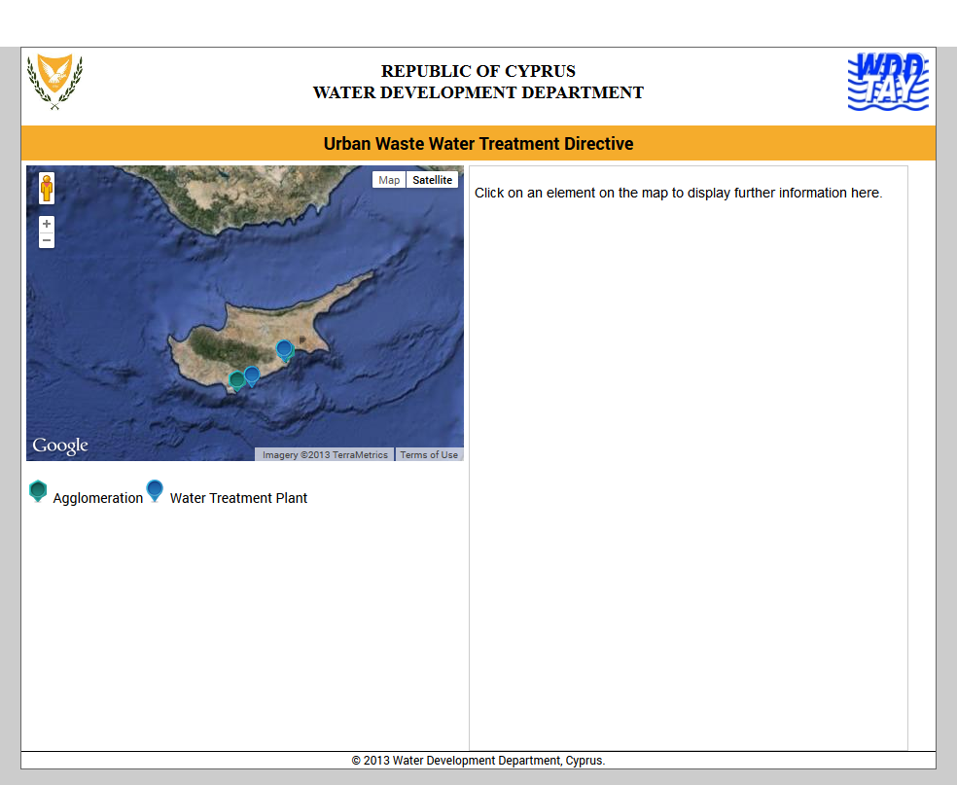
  Spatial data of the CY GIS-system are INSPIRE-compatible

Slide 16
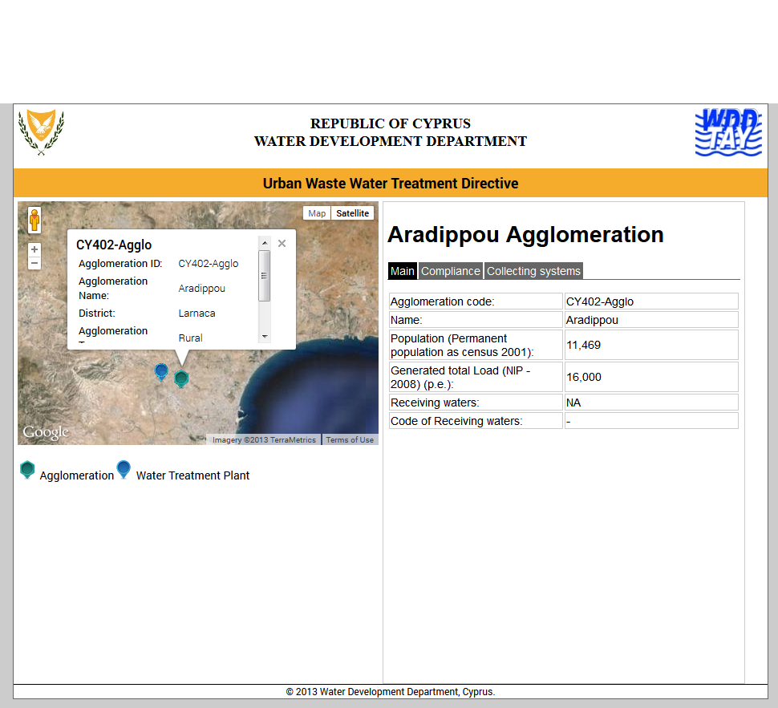

Slide 17
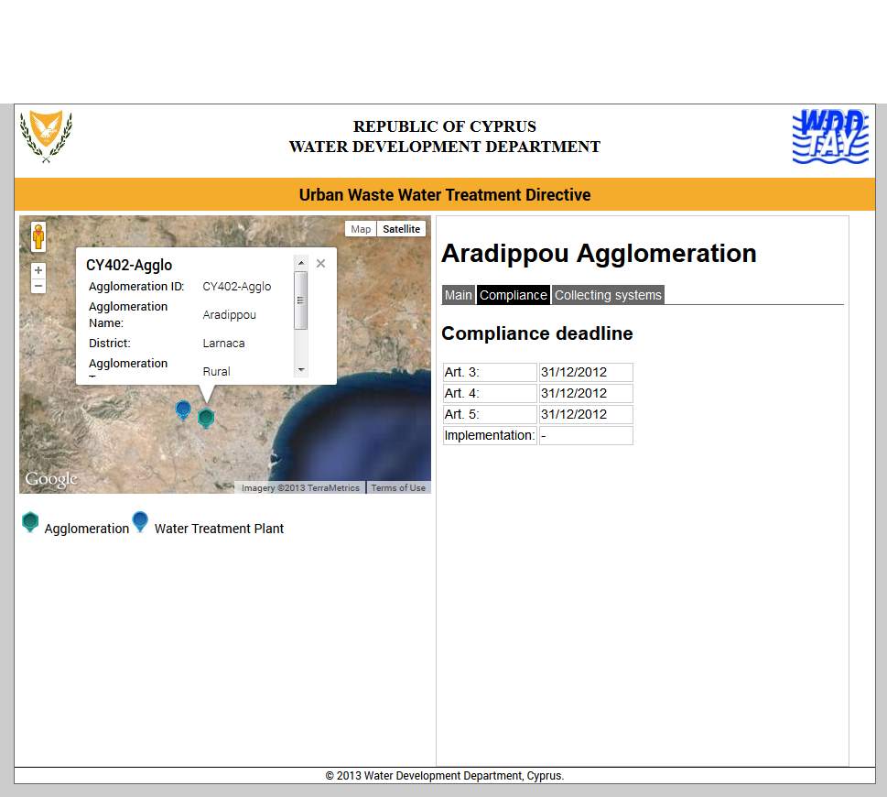

Slide 18
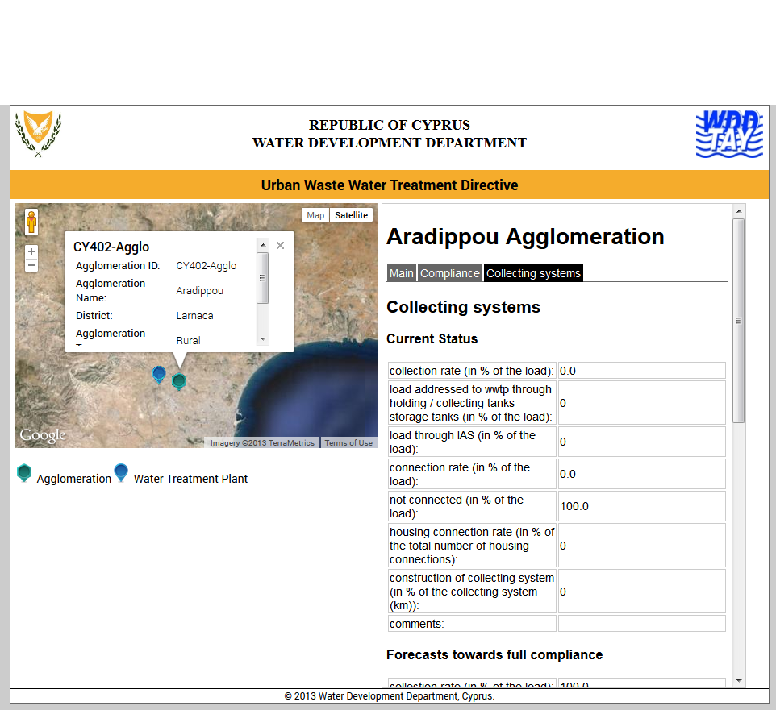

Slide 19
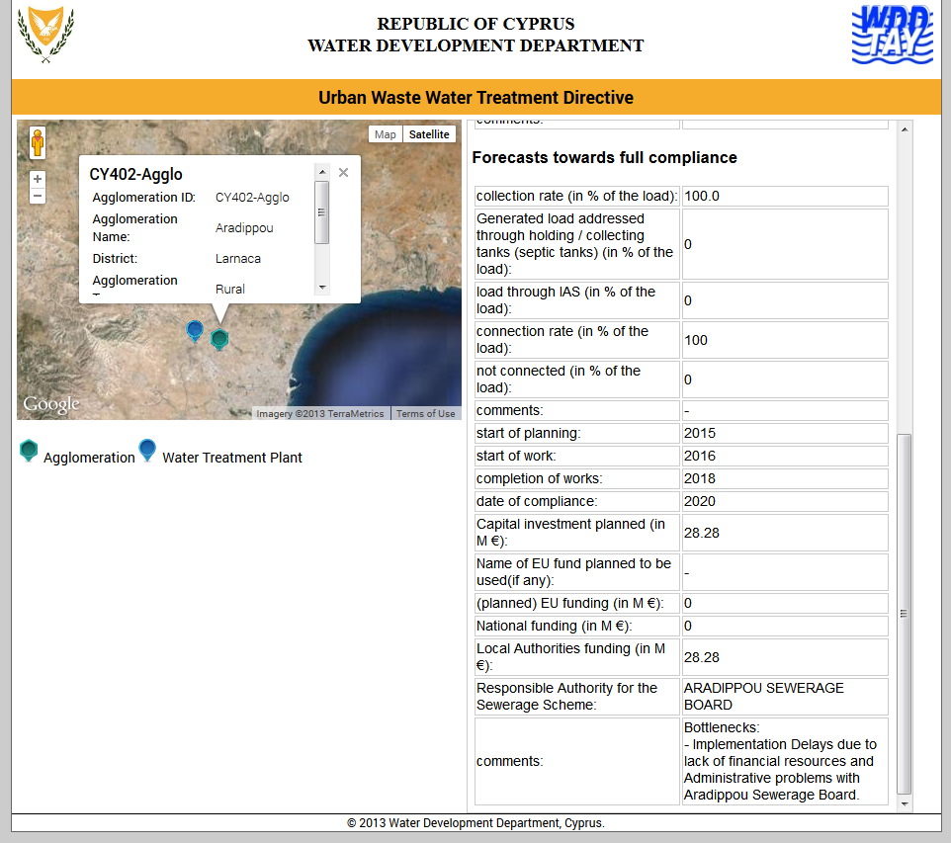

Slide 20
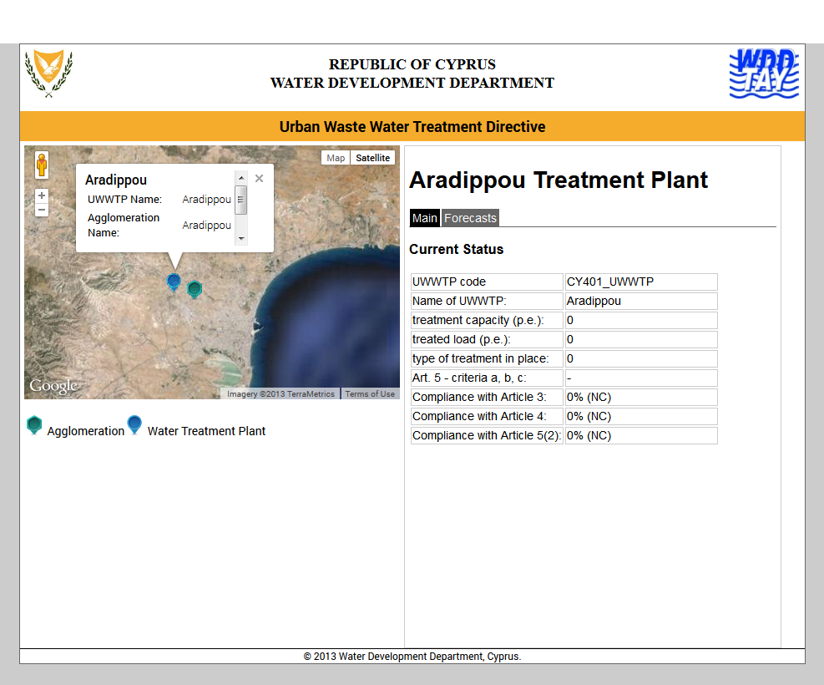

Slide 21
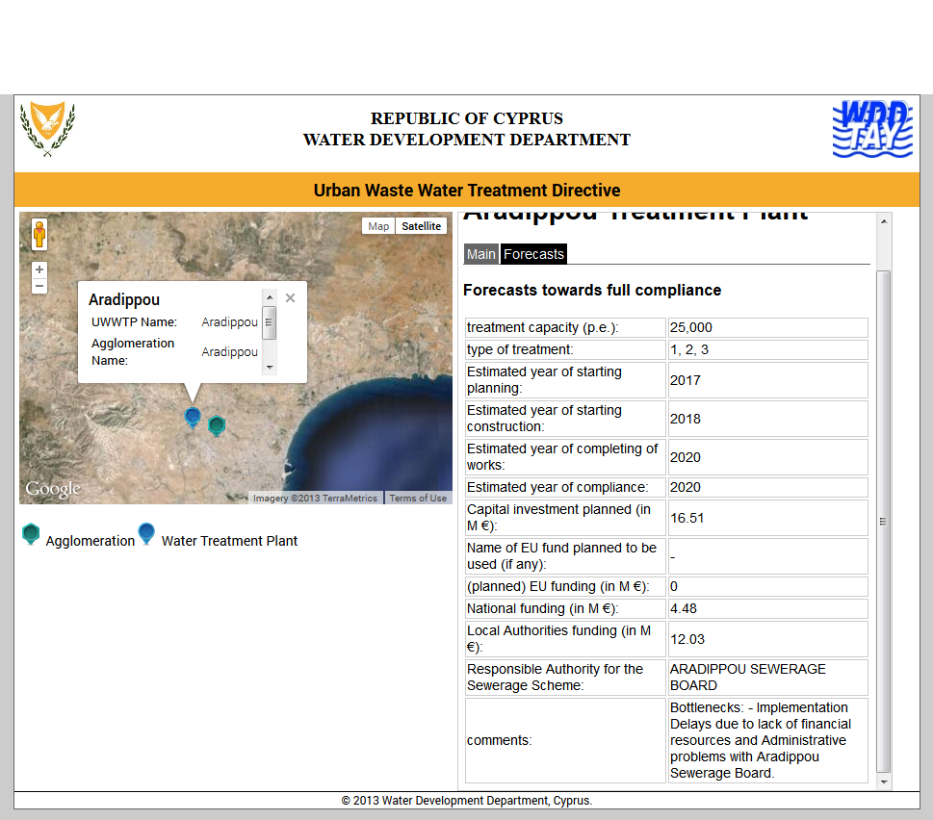

Slide 22
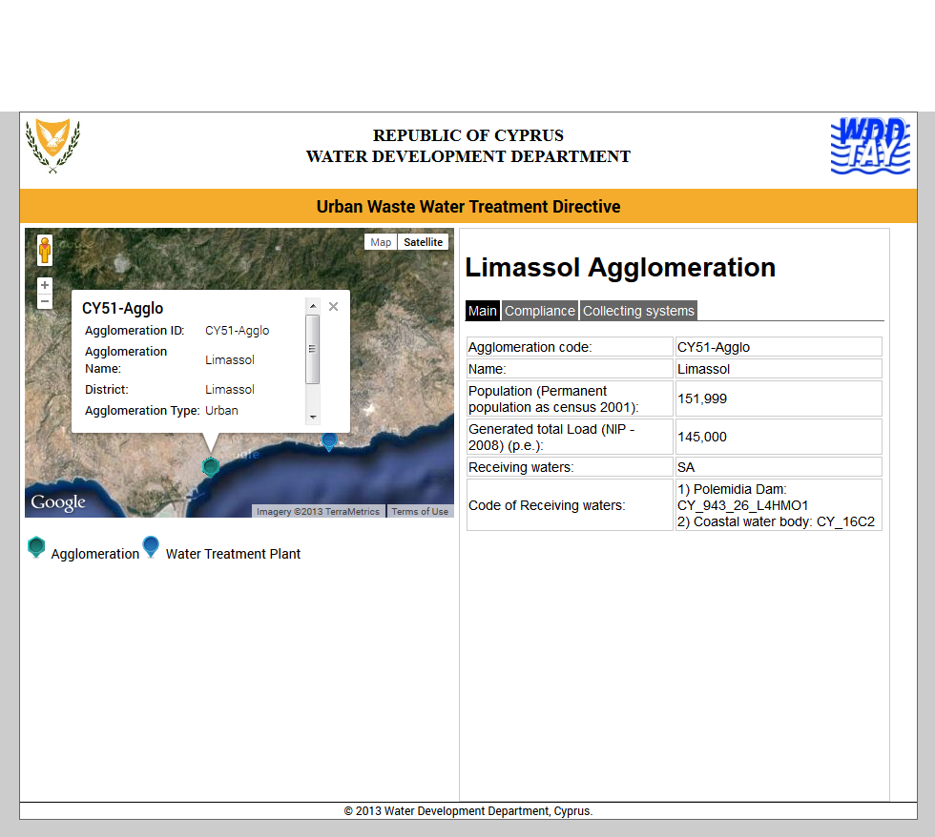

Slide 23
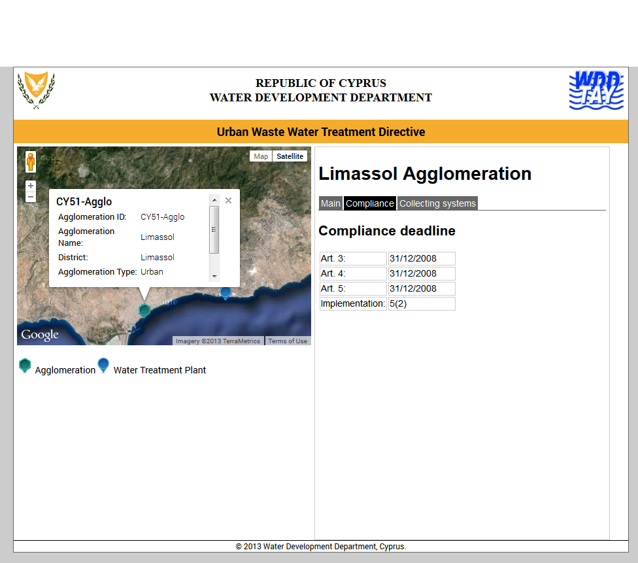

Slide 24
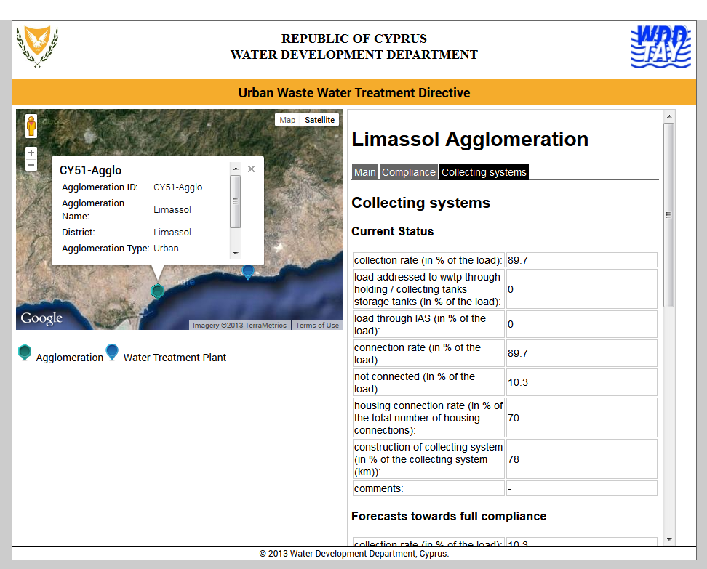

Slide 25
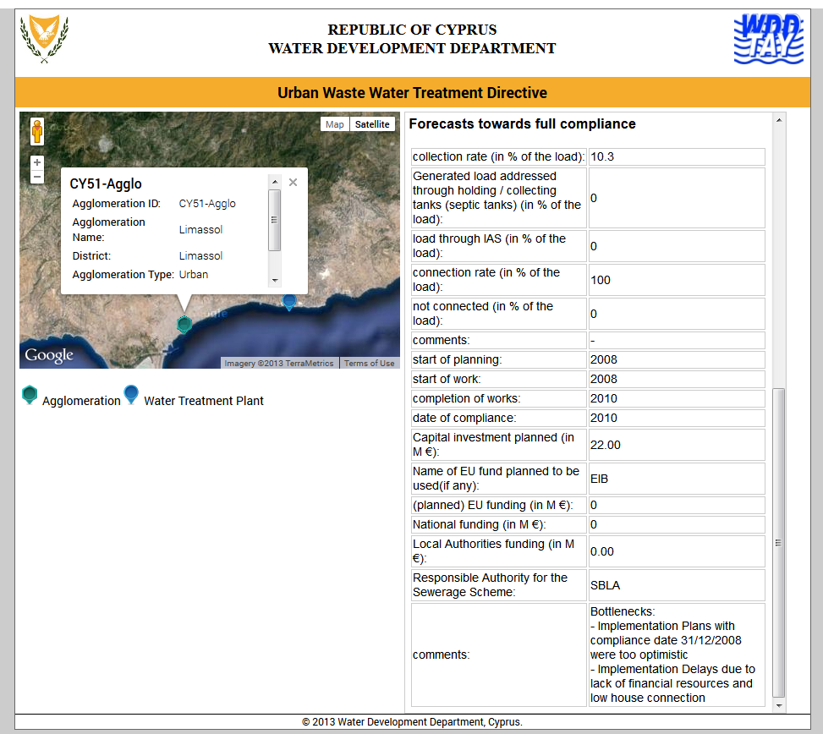

Slide 26
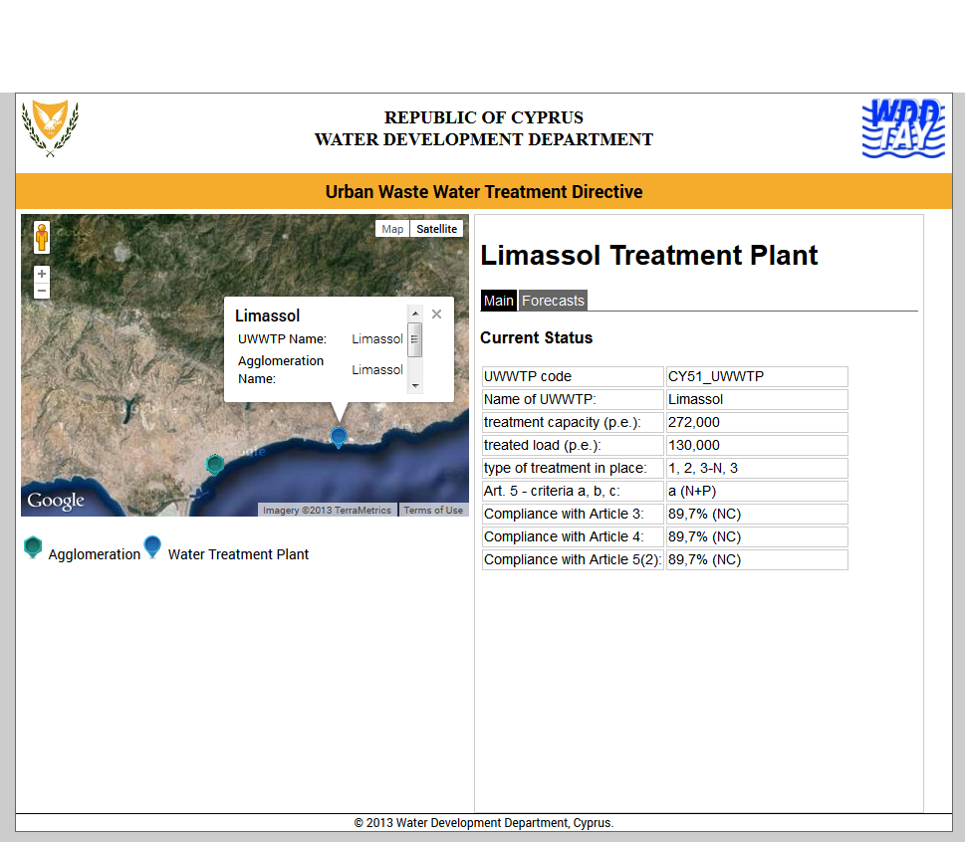

Slide 27
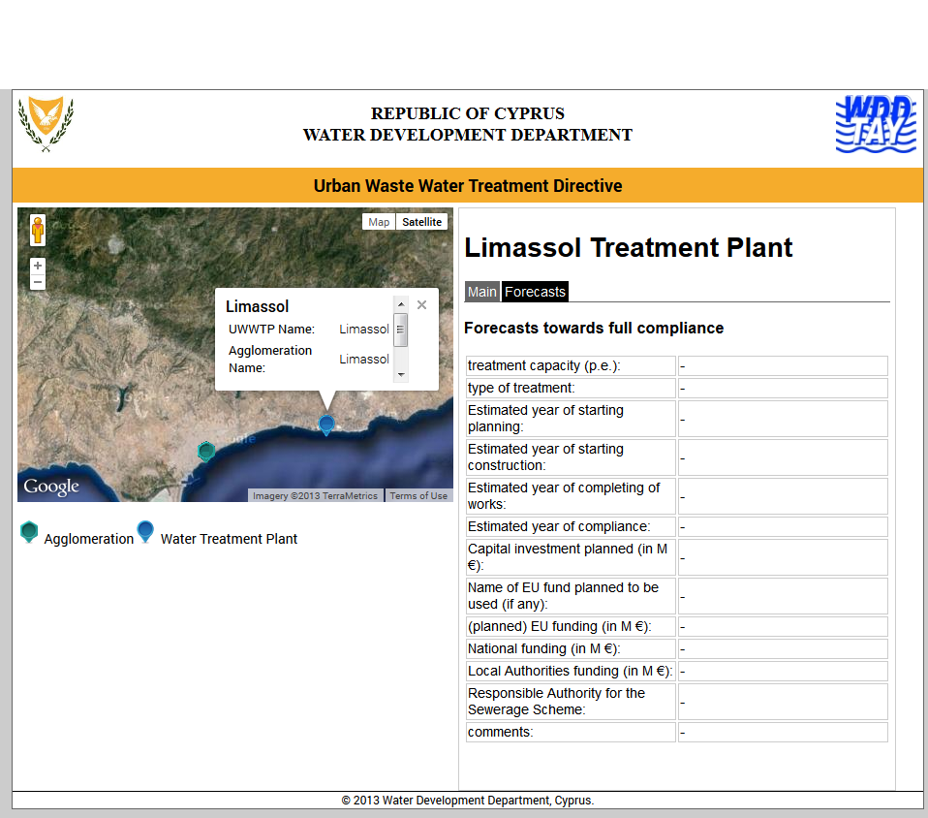

Slide 28
SIIF Excel Template Parameters on National Level
Difficulties encountered in future completing SIIF Excel Template Parameters
  Data Collection
    No regular update of data arising from the operation of the sewerage systems (e.g. flows, loads etc). These data are only obtained from Sewerage Boards on demand for reporting purposes, according to the frequencies and the requirements of the Directive.
    Administrative procedures (time consuming)
    Lack of human resources to collect additional data
  Data Management
    No available database/information system to manage data
    Lack of financial resources to build a database/information system
    Lack of human recourses to manage data

Slide 29
Concluding Remarks
Cyprus is focused on the implementation of the UWWTD 91/271/EEC.
Cyprus has expressed interest in becoming pilot MS in the UWWTD SIIF project for the implementation of the UWWTD and public information.
Cyprus is still studying the idea of developing and implementing a national UWWTD SIIF.
Current Financial situation creates major concerns.
Cyprus is expecting financial assistance and training by the EC to set up a national UWWTD SIIF.

