Slide 1

UWWTD expert group meeting
9 November 2015
Point 1.1.
Structured Implementation and Information Framework (SIIF)
the concept
European Commission
Directorate General for Environment
Unit C.2 - Marine Environment & Water Industry
Bruno Rakedjian
Notes:
x

Slide 2
THE DEFINITION OF THE SIIF CONCEPT

Slide 3
SIIF
the overall aim
The SIIF concept is an ongoing DG ENV pilot project essentially focused
on the organisation and management of data in order to enhance the generation and dissemination of information(for policy makers, interested parties and the public) on how legislation is practically implemented
The concept developed is in line with the provisions of the Public Access to Environmental Information (2003/4/EC) and INSPIRE Directive (2007/2/EC)

Slide 4
The content
SIIF
The SIIF concept is composed of
a governance approach
and
an IT system

Slide 5
The governance
SIIF
The SIIF implies a governance focused on compliance, good environmental status, environmental pressure and impact, economic activities and jobs creation.
It has also an objective to reduce administrative burden, provide more up-to-date data, increase efficiency to all potential users.
The existence of an implementation programme on how to reach or maintain the compliance for a policy is also part of the SIIF governance (e.g. Article 17 under the UWWTD)

Slide 6
The IT content
SIIF
SIIF is also an IT system that is divided in three components:
The content for data community
The process for data providers
The dissemination for data users
Each of its components have to comply with specific principles

Slide 7

The IT system
SIIF
SIIF
Integrated EU tools
on EU policies
for data community,
data providers
and
data users
Focus on user's need
Ease the access and sharing
Be user-friendly to use
View, Invoke,
Download,
Discovery,
Transformation
Services
Data Users
Dissemination
Process
Data providers
Collection and QA/QC tools
Decentralise assessment and qualification
Content
Data Community
Inspire Harmonisation, Data model,
Dataset, Guidance, qualification rules
Be accurate and comparable

Slide 8
The content
SIIF
SIIF contributes to the digital, growth, jobs and investments agenda.

Slide 9
THE CONCRETE IT DEVELOPMENTS UNDER SIIF

Slide 10
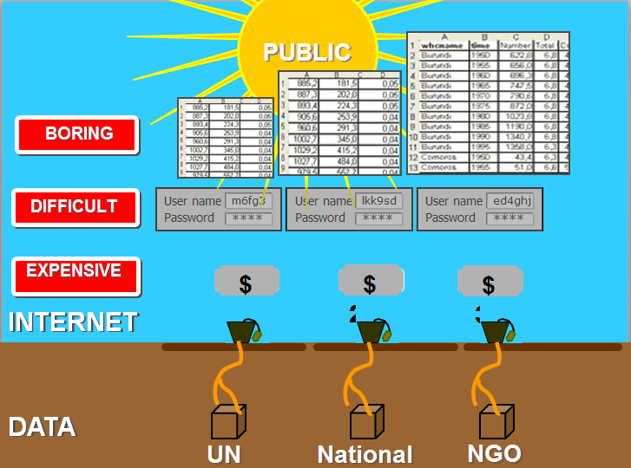
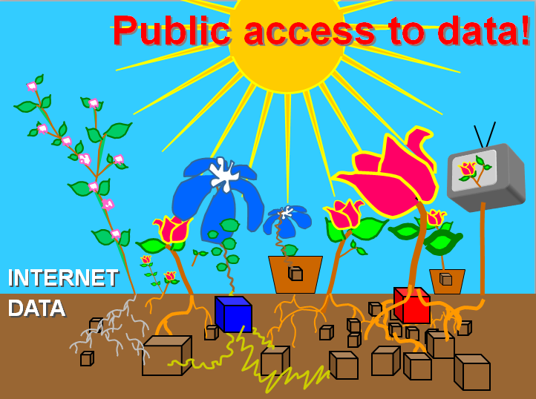
SIIF
The first priority of the SIIF IT development: improvement of dissemination of data
Reference Slides from Hans Rosling TED video (15 minutes after the beginning)
https://www.ted.com/talks/hans_rosling_shows_the_best_stats_you_ve_ever_seen
and improvement of the reporting process

Slide 11
SIIF
The first operational Brick
Implementation of an open source dissemination IT toolbox.
Providing EU MS a cheap way to implement the Article 11 of the INSPIRE directive and thus to develop their national waste water website.
The framework of this website can also be adapted to be used in other European Policies.

Slide 12
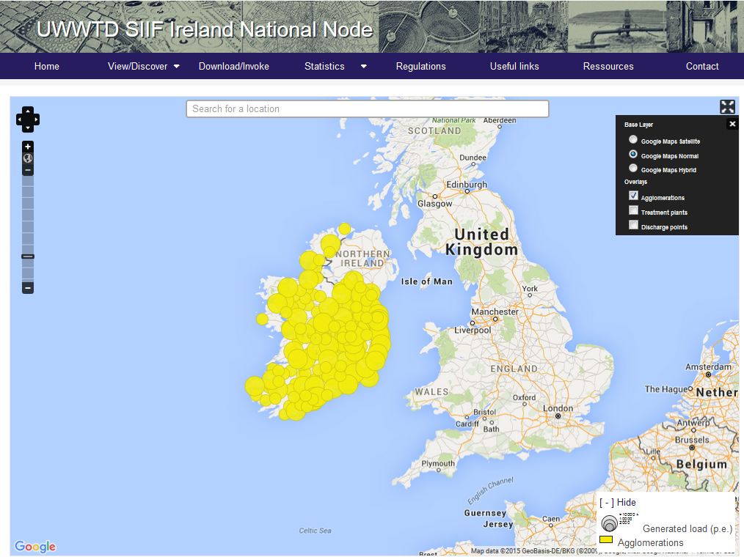
SIIF
The first operational Brick
Generic waste water dissemination tool useful for national dissemination of waste water data http://uwwtd.oieau.fr/

Slide 13
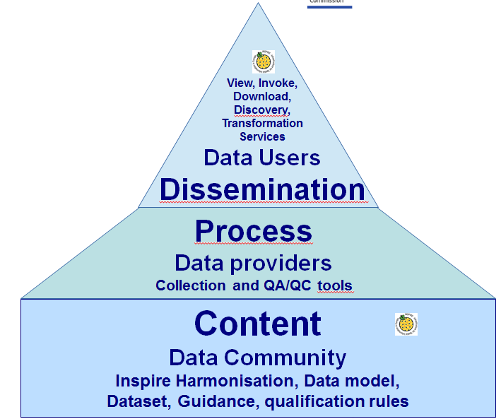
What has been done and has still to be done
The other bricks
SIIF-UWWTD
Answer given by ongoing SIIF project for MS that are not able to developp their own website
Answer partially given by the ongoing development above and by the tools provided by EEA/ETC
Need to have a good collection tool at national level. (weakness of the reporting process for some MS)
Is there a need to develop a European generic collection tool adapted to the data model ?
Existing common data model, QA/QC rules and guidance for UWW policy
Has to be improved to go totally to INSPIRE harmonisation and to answer to other national/European/world needs.
Choice between a lonely MS approach or a common approach.

Slide 14
SIIF and the frequency of reporting

Slide 15
Change of frequency is part of the solutions to answer to the objective to reduce administrative burden, to have more up-to-date data and to increase efficiency New proposal for UWWTD - Each 2 years →agglomerations of more than 10 000 p.e. and not compliant situations ( Article 15 and 17) - Each 4 years → all agglomerations of more than 2000 p.e. (Article 15 and 17)

Slide 16
Thank you for your attention
bruno.rakedjian@ec.europa.eu
Notes:
x

