Slide 1
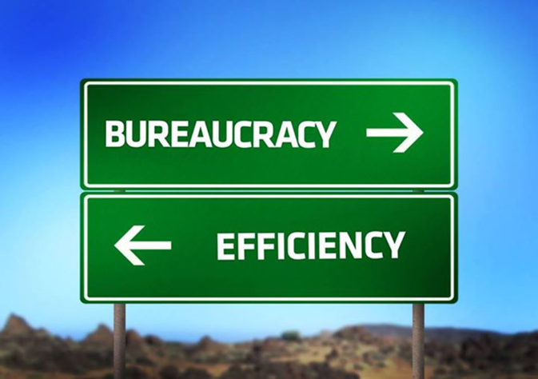
Review of Environmental monitoring and reporting
UWWD group
Joachim D'Eugenio
DG Environment
European Commission

Slide 2
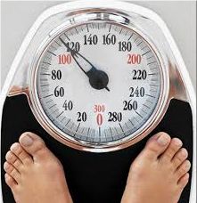
Better Regulation and the environmental acquis
May 2015 package on Better Regulation
  REFIT Platform
  External members on the Regulatory Scrutiny Board
  New guidelines for Evaluation and Impact Assessment
  Emphasis on consultation
DG Environment has REFIT evaluation commitment:
  Environmental Liability Directive, INSPIRE evaluations in 2015
  Fitness checks on Nature and EMAS and Ecolabel in 2016 plus Evaluations on Noise, VOCs, EPRTR
  Continual stream for future including Chemicals FC
  New, horizontal review of reporting

Slide 3
Extract from the Better Regulation
Communication of 19 May 2015
Launch a broad review of reporting requirements to see how burdens can be alleviated. This review will have a particularly strong focus on areas where stakeholders have recently indicated their concerns, such as agriculture, energy, environment and financial services.
Cooperate with certain Member States which are examining the best ways to ensure compliance with EU law at national level and have initiated a review of how well EU and Member State regulation combines to help protect the environment (the 'Make It Work' initiative). The objective is to identify commonly used instruments and procedures across directives to see where duplication, varying definitions and terms can be reduced while maintaining the level of protection in the legislation and improving the efficiency of its application.

Slide 4
Better results for environmental legislation
Success factors for improving compliance and implementation across all (environment) legislation are:
  Clear legislation
  Strong political will / support
  Sufficient financing of actions
  Excellent technical know how
  Good evidence base
  Good governance and
  administrative efficiency
Better implementation and enforcement
Strong political will / support
Clear legislation
Suffienct financing
Good governance / admin. efficieny
Excellent technical know how
Good evidence base

Slide 5
Some facts & figures
Estimated costs at €1.2b per annum of environmental information obligations to business and Competent Authorities
(based on limited selection of most expensive obligations, the costs significantly influenced MS choices on content and processes)
Impacts assessment found:
  for Industrial Emissions Directive found potential for administrative burden reduction of €2m/year through streamlined reporting and monitoring;
  for Waste Framework Directive, significant savings for simplification of reporting: 980 man-days/year in total for the EU (40 for COM).
In 108 EU acts linked to the climate and environment, there are
432 "reporting obligations" for the Member States and
138 "reporting obligations" for the Commission
(to the Council and the EP)
Despite all the reporting, we often cannot answer key policy and implementation questions (e.g. about effectiveness, costs, benefits or administrative burden)

Slide 6

Review of reporting as announced by the Better Regulation Communication will help to achieve the following priority objectives:
(4) to maximise the benefits of Union environment legislation by improving implementation;
(5) to improve the knowledge and evidence base for Union environment policy;
Notes:
Priority objectives (4) to maximise the benefits of Union environment legislation by improving implementation introduces the following actions:
"65. In order to maximise the benefits of Union environment legislation by improving implementation, the 7th EAP shall ensure that by 2020:
(a) the public has access to clear information showing how Union environment law is being implemented consistent with the Aarhus Convention;
(b) compliance with specific environment legislation has increased;
[…]
This requires, in particular:
(i) ensuring that systems at national level actively disseminate information about how Union environment legislation is being implemented, and complementing such information with a Union level overview of individual Member States’ performance; […]"
Priority objectives (5) to improve the knowledge and evidence base for Union environment policy introduces the following actions:
"73. In order to improve the knowledge and evidence base for Union environment policy, the 7th EAP shall ensure that by 2020:
policy-makers and stakeholders have a more informed basis for developing and implementing environment and climate policies, including understanding the environmental impacts of human activities and measuring the costs and benefits of action and the costs of inaction; […]
(iii) simplifying, streamlining and modernising environmental and climate change data and information collection, management, sharing and re-use, including the development and implementation of a Shared Environmental Information System […]"

Slide 7



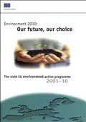

The story of environmental
reporting
1995/6
SRD
questionnaires
2002
WISE concept
born (e-reporting for all water legislation)
2007
INSPIRE
adopted
WISE portal
launched
2009
2013
7th EAP
1992
Standardised
Reporting Directive
(SRD)
2002
6th EAP
2012
Implementation Communication
2015
Better Regulation initiative starts
2005
2008
Shared Environment Information System (SEIS)

Slide 8
The objective
To develop more modern, efficient and effective regulatory monitoring building on the past successes to support the following specific objectives:
Better results on the ground
(i.e. higher implementation and compliance rates);
Less pressure on public and private sector contributing to reporting (administrative burden reduction);
Better information and empowerment of citizens
(i.e. transparent and public available information);
Facilitating Better Regulation in environment policy
(i.e. having the evidence base for evaluation and IAs).

Slide 9
Three areas of work
Area 3: the content
Area 2: the process
Area 1: the timing
Lower frequency of reporting
Better synchronisation
Efficiency gains through
automisation
harmonisation
centralisation
Less data requested
Ensure key performance Indicators
Less text more automised data

Slide 10
Area 1: the timing
Looking across legislation and identification of synergies / alignments
Inventory should exist, at least sectorial, needs to be updated and completed
Some examples already implemented, other potential synergies already identified (e.g. HBD/MSFD or NiD/WFD)
Legislative change vs. practical arrangements

Slide 11
INSPIRE / SEIS / SIIF have addressed this in detail, no need to re-invent the wheel
Full implementation of INSPIRE prerequisite
(REFIT/Art 23 report important and part of this initiative)
Outside INSPIRE – business process optimisation of transmission from national reports to EEA – standardisation across policy areas (incl. QA/QC)
Area 2: the process
Long term: „zero reporting vision“ based on full implementation of access to information (active dissemination)/INSPIRE Directive
…but „data harvesting“ (pull system) is long time away
... what interim solution do we develop ?

Slide 12
Most complex, driven by legislation /
policy area
Partial inventory should be available (eg Reportnet) but most time consuming and complex – start with screening
Promotion of active dissemination at MS level in a structured way (SIIF)
Area 3: the content
Mid term: Explore ideas of „key performance indicators“ and “bonus“ (less reporting) for compliant MS

Slide 13
The data flow process
International organisations (e.g. UN)
1: local
Individual data(sets)
2: regional
First level of (spatial) aggregation
3: national
Second level of (spatial) aggregation
4: EU (COM/EEA)
COM/EEA
report
EP / Council

Slide 14
Next steps/
milestones
2015:
Publish roadmap and launch stakeholder consultation
19/20 November: Workshop with MS, stakeholders, NGOs
2016:
Adoption of INSPIRE REFIT report
Possible repeal of Standardised Reporting Directive (SRD-91/692/EEC) – COM proposal
2017:
Presentation of results of the reporting review including possible suggestions for further actions

Slide 15
Make it Work
Netherlands / UK / Germany - led initiative with other MSs involved to varying degrees
Already suggested drafting principles for compliance assurance and now working on principles for reporting
Workshop on 19/20 November key event for developping
MS input – need for reporting experts from MS from all different policy areas (including water) to contribute
-> Please get in touch with your MiW expert … see circulated list
For details, please look at workshop web page:
http://www.ieep.eu/work-areas/environmental-governance/better-regulation/make-it-work/events/2015/09/workshop-on-reporting-brussels-nov-2015

Slide 16
INSPIRE work
Commission is finalising implementation report and REFIT evaluation – one finding is that implementation should become more targeted in assisting ENV legislation
Commission is launching bilateral discussions with all MS and will raise the issue of priority setting in the INSPIRE MIG (policy) meeting in December –> MS will be invited to develop action plan together with policy departments
Priority setting focusses on reporting obligations from now until 2019 (including WFD) –> dialogue between INSPIRE experts and policy departments needed
Next INSPIRE Conference (end Sept 2016 in Barcelona) will focus on INSPIRE in support of implementation of ENV legislation

Slide 17
Conclusions
WFD, UWWD and WISE have a lot to contribute to reporting review process
Input to INSPIRE implementation process and MiW workshop from UWWD group welcome (needed!)
Horizontal process will be relevant for future work under the UWWD reporting

Slide 18
Questions?
Thank you for your attention!
Contacts:
Steve White (Unit ENV. F1) stephen.white@ec.europa.eu
Joachim D'Eugenio (Unit ENV D.4) joachim.d'eugenio@ec.europa.eu

