Slide 1
‘NATIONAL (UWWTD – SIIF)’
Gap Analysis & Draft Concept
  Aleš Veršič, M.Sc,
  Slovenian Environmental Agency
  Nataša Vodopivec, M.Sc,
  Ministry for Agriculture and the Environment

Slide 2
Topics
Current status of databases (DB) and Information systems (IS) in RS
Gap analysis
Measures to resolve current obstacles
Draft concept of national UWWTD_SIIF
2

Slide 3
Current status of DB and IS
Basic datasets and IS important for UWWTD are managed by:
Ministry of Agriculture and the Environment (MKO):
    Public Services for Environmental Protection and Investments in Environment Directorate (MKO-DJSI),
      Public Services for Environmental Protection Division,
      Cohesion Policy Division,
  Slovenian Environment Agency (ARSO),
Ministry of infrastructure and Spatial planning (MzIP):
  Surveying and Mapping Authority of the Republic of Slovenia (GURS)
Ministry of Economic Development and Technology (MGRT):
    Division for Regional Development Implementation
3

Slide 4
Current status of DB and IS
Public Services for Environmental Protection Devision (MKO-DJSI)
Database of urban waste water and run-off rain water collection and treatment - IS IJSVO:
  Register of providers of public services
  Register of drinking water systems
  Register of sewage systems
  Register of drinking water reservoirs
  Database for municipal waste management
4

Slide 5
Current status of DB and IS
Register of sewage systems contains datasets of:
  Settlements (where IJS have public service Collection and Treatment)
  Information on the type of sewage system for each particualar building
  Data on point sources of industrial waste water, connected to public sewage system
  Data on collection / connection rate to public to public sewage system for particular agglomeration
  Link between agglomeration and WWTP (based on ID of WWTP)
  Some other data on sewage system, such as:
    Water balance
    Load balance
    Quantity of waste
    Information on rain water collection in the system
    Link between sewabe system and municipality
5

Slide 6
Current status of DB and IS
Slovenian Environment Agency (ARSO)
Database on water emissions: Water Emission Information System (WE IS):
  Register of WWTPs
  Database on emissions from WWTPs
  Register of installations discharging industrial waste water
  Database on emissions from installations discharging industrial waste water
6

Slide 7
Current status of DB and IS
Slovenian Environment Agency (ARSO)
Database on spatial data (WFD data …, hydro network, …)
  RBDs, river basins / sub-basins and surface- and groundwater bodies (according to WFD)
Database on state of surface- and groundwater: “EkoVODE”:
  Surface- and groundwater status (according to WFD)
  Bathing water quality (according to BWD),
  Quality of surface water intended for the abstraction of drinking water (according to WFD)
  Quality of surface water for fish / shellfish life (according to Fish Directive and Shellfish Directive)
7
Notes:
7

Slide 8
Current status of DB and IS
Surveying and Mapping Authority of the Republic of Slovenia (GURS)
Cadastre of Public Infrastructure (ZK GJI):
  Transport infrastructure (state roads, railways)
  Energy infrastructure,
  Urban public infrastructure (drinking water distribution system, sewage system, waste management - landfills),
  Water infrastructure
  Other infrastructure of national importance
8

Slide 9
Current status of DB and IS
Surveying and Mapping Authority of the Republic of Slovenia (GURS)
  Register of spatial units (administrative units)
  Register of real estate
  Building cadastre
9

Slide 10
Current status of DB and IS
Ministry of Economic Development and Technology (MGRT)
Information System for monitoring, reporting and performing EU Cohesion policy in RS (ISARR):
  Financial management of projects
  No geo-referenced data included
Cohesion Policy Division (MKO)
  Local evidence (some Excel sheets for daily work purposes) on financing from Cohesion Fund
  Users of ISARR (CF projects)
Division for Regional Development Implementation (MGRT)
  Local evidence (some Excel sheets for daily work purposes) on financing from European Regional Development Fund
  Users of ISARR (ERDF projects)
10
Notes:
10

Slide 11
Gap analysis
Preliminary results / most obvious gaps:
  Different information systems in different institutions involved in the implementation of UWWTD
  Different information systems are not connected appropriately (different IDs of WWTP in different databases, different IDs of sewage system in ZK GJI)
  Lack of focused information systems for particular purpose (e.g. focused on the implementation / compliance with UWWTD; implementation / compliance with BWD, etc.)
11

Slide 12
Measures to resolve current obstacles
Proposed short term measures (under discussion):
  Establishment of connections between current information systems (IJSVO and WEIS)
  Establishment of web-services for additional data from IJSVO to be shown on Atlas okolja
  Establishment of web-services based on WFS for relevant data from ZK GJI to be shown on Atlas okolja in real-time
  Migration from Atlasa okolja to application based on JavaScript API technology
Timelines / financing:
    2 - 3 months (depend on available financial, human resources)
    Cohesion Fund (2007 - 2013)
12

Slide 13
Measures to resolve current obstacles
Proposed mid-term measures (under discussion):
  Preparation of project documentation for development of IS (National UWWT_SIIF)
  Investment in IT Infrastructure for National UWWT_SIIF
Timelines / financing:
    7 - 8 months (depend on available financial, human resources)
    Cohesion Fund (2007 - 2013)
13

Slide 14
Measures to resolve current obstacles
Proposed long-term measures (under discussion):
  Development of National UWWTD_SIIF
  Ensuring (sufficient) human resources (IT expert and UWWTD expert) for management of UWWTD_SIIF
Timeline / financing:
    12 - 15 months (depend on available financial, human resources)
    Cohesion Fund (2014 - 2020)
14

Slide 15
Draft concept of national UWWTD_SIIF
Activities in progress:
National Expert Working Group (EWG) for National UWWTD_SIIF formed; members of EWG: representatives of MKO, ARSO, MGRT, MzIP, GURS, IzVRS
Main tasks of EWG:
  Development of concept of National UWWTD_SIIF
  Discussion on centralised or decentralised IS at National level?
  Development of “Atlas UWWTD” (draft version):
  http://gis.arso.gov.si/gis/profile.aspx?id=UWWTD_AXL@Arso
  Preparation of public tenders for short- and mid-term measures
  Revision of legislation / Art. 17 action programme (if necessary)
15

Slide 16
Proposed IT
  CMS (Joomla, Drupal, WordPress,…)
  XML
  RDF
  SPARQL
  GML
  WFS
  WMS
  ArcGIS JavaScript API
  Oracle BI
16

Slide 17
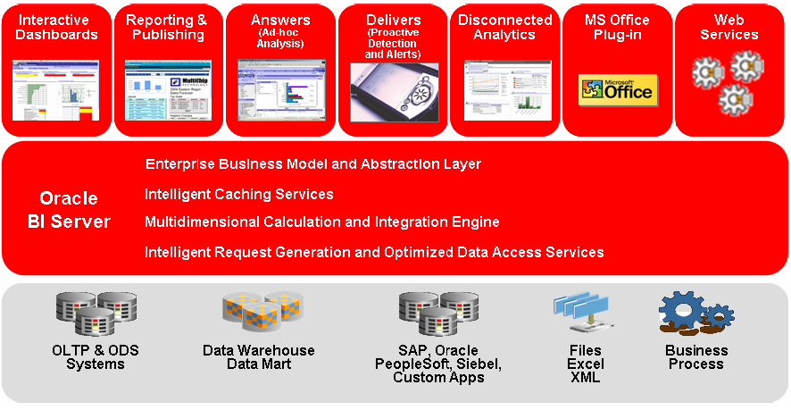
Proposed IT
Oracle BI
17

Slide 18
Contacts
UWWTD aspects:
Nataša Vodopivec, M.Sc
Ministry for Agriculture and the Environment
Environment Directorate, Environment and Climate Change Division
SI-1000 Ljubljana, Dunajska cesta 22
Phone: + 386 1 478 7317
E-mail: natasa.vodopivec@gov.si
IT aspects:
Aleš Veršič, M.Sc
Slovenian Environmental Agency
SI-1000 Ljubljana, Vojkova 1B
Mobile Phone: + 386 41 336 420
E-mail: aversic@gov.si
18

Slide 19
Thank you for your attention
19
Notes:
19

