Slide 1
ESS EA TF : Progress report
Enterprise Architecture Reference Framework (ESS EA RF)
Item 5 of the Agenda of the DIME/ITDG SG
24 February 2015

Slide 2
Objectives
Report on the progress and next steps for the development of ESS EA Reference Framework
Present the main elements the ESS EA Reference Framework and their use in the context of Vision implementation
Collect feedback and decision on the way forward

Slide 3
ESS Vision 2020: the role of EA
"We will develop an ESS reference enterprise architecture to enable a systematic and coherent approach to the production of European statistics."
"We will adopt enterprise architecture as a common reference framework"
"The Generic Enterprise Model for Statistics (GEMS) model will be further developed using an enterprise architecture approach, in order to translate the vision for reengineering the production into implementation strategies encompassing all 4 layers of the enterprise - business, information, technology and applications"

Slide 4
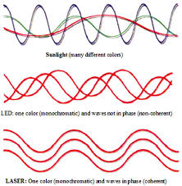
ESS Vision 2020: the role of EA
Enterprise Architecture = "coherence assurance"
Vertical coherence: implementation reflects strategy
Horizontal coherence: developments in different projects/domain are consistent
EA provides decision-makers/project managers with tools and expertise to ensure and monitor coherence

Slide 5
ESS EA Reference Framework
Joined undertaking of ESS EA TF since Feb 2014 (3 physical meetings, one Sprint Session, numerous subgroup conference calls).
Establish common language/approaches for Enterprise Architecture for ESS Vision Implementation
Produce reference conceptual documents and guidelines to be used at different levels and stages to ensure the coherent implementation of the ESS Vision 2020

Slide 6
ESS EA Reference Framework
Scope :
  ESS Vision Implementation
  the 4 Enterprise Architecture layers (Business, Information, Application and Technology)
  Focus on Statistical Production
Primary target audiences:
  ESS architects working with project
  ESS Vision 2020 project managers
  ESS leaders (business and IT)
Flexible framework enabling the development of more specific (solution) architecture

Slide 7
ESS EA RF v 0.4 components
Business Capabilities
Describes what the ESS does or needs to do to implement the Vision
Statistical process flow model
Describes generically how the ESS operates the different capabilities to meet user/information request
Principles
Guidance and rules to ensure coherence over the lifetime of a project
Architecture building blocks
Describes the high-level functional components needed to implement the capabilities
All artefacts are interlinked and made coherent with the ESS Vision 2020

Slide 8
ESS EA RF gaps
ESS Statistical Production Reference Architecture
Gathers key business function architectures and
scenarios for ESS deployment (Opt-in Opt-out)
Security Architecture
Describes the key components of security and their impact on the different EA layers
Information Architecture
Provides the glue for Business and Application Architecture
Identifies information assets/data entities
Identifies key information capabilities
Establish bridges between
concept and implementation
business and application

Slide 9
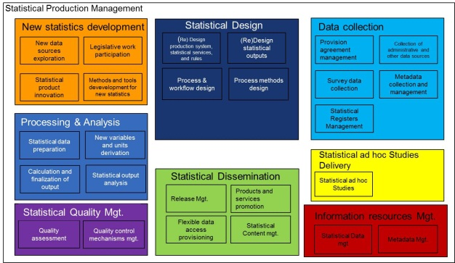
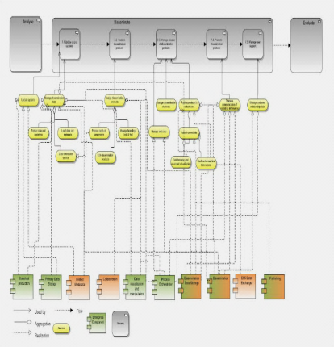
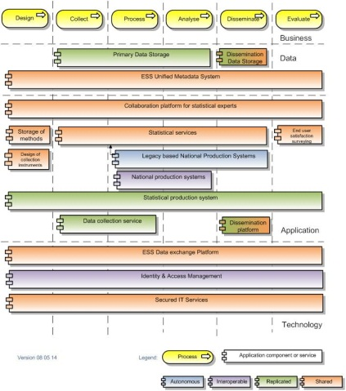
ESS EA Reference Framework and EA layers
Business
Business Capabilities
ESS Statistical Production Reference Architecture
Information
Application
Architecture building blocks
Technology
Implementation
Notes:
The work on the ESS EA Reference Framework is progressively moving from the most abstract business layers (e.g. BCM) to elements which can provide guidance for actual solutions (BFAs). This top-down approach aims at ensuring the coherence of Vision implementation.

Slide 10

ESS EA RF artefacts and project life cycle
Strategy
Planning
Execute
Manage
Origination & Initiation
Planning & Prelim Design
Build/Test/Deploy
Post-Implementation Transition
Business Capabilities
Business Capabilities
Architecture building blocks
ESS Statistical Production Reference Architecture
EA Principles
VIG - STRATEGY
PROJECT/PROGRAMME MANAGEMENT
Notes:
If we look at the elements created so far as part of the EA Reference Framework from the point of view of a project, this graph shows us where they come into play:
The BCM is most important at the initiation and post-implementation phase: at the initiation phase, the BCM is to be used to assess whether a project addresses the prioritised business capabilities. At the end, the results of the project need to be taken into account to update the BCM
The EA BB can be used in the planning phase to ensure that the project's solutions are in line with the interoperability objectives set for the concerned Building Blocks
The EA Principles support the project from inception to end
The Business Function Architectures will intervene by providing input for the architecture of the actual solution

Slide 11
Next steps for ESS EARF
Now : Feedback DIME-ITDG V0.4 -> issue log
5-6 March 2015: 4th Meeting of the ESS EA TF
  Gap analysis
  ESS Statistical Production Reference Architecture
  Communication
  Governance
April 2015: VIG meeting
May 2015 : Last meeting of the ESS EA TF
June 2015: V0.9 submitted to DIME-ITDG for formal opinion
Sept 2015: Possible adoption by ESSC

Slide 12
Item for opinion
Feedback on V0.4
Extension of the mandate ESS EA TF : finalise ESS EA RF by August 2015
Role of the ESS EA TF : development of "industry" capability model in cooperation with SN ?
DIME-ITDG SG : discuss mandate and role for an ESS EA expert group
Adoption of ESS EA RF as an ESS standard: Stakeholder consultation and eventually adoption by the ESSC

