Slide 1

2nd SIIF UWWTD workshop, 20 October 2013, Brussels
The current UWW information tools
available from WISE water data centre at EEA
in progress ..
in general on SIIF / WISE relations
Bo N Jacobsen
bo.jacobsen@eea.europa.eu
Notes:
1

Slide 2
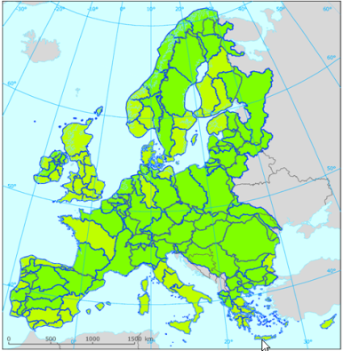

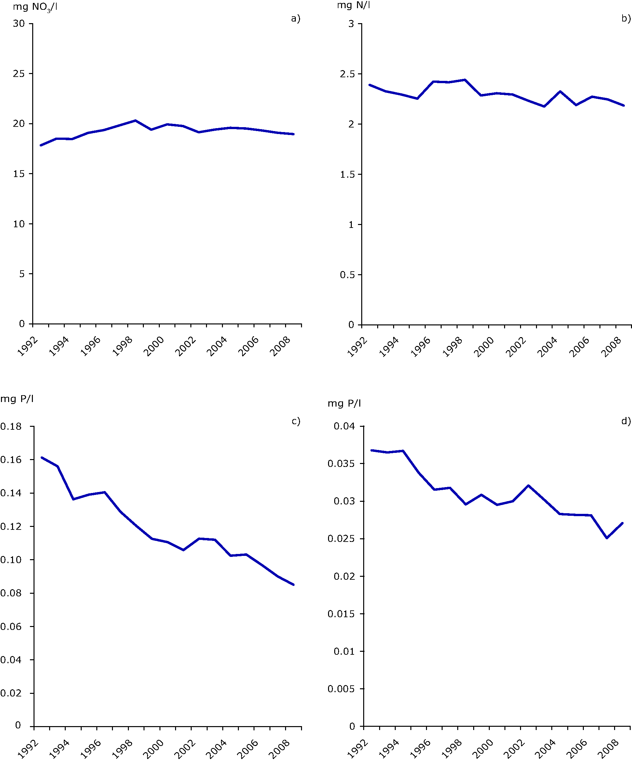
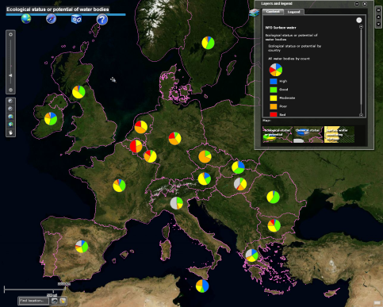
Flows of information
Expansions
Floods Directive
Marine Strategy Framework Dir.
Sharing
Additional paramaters
Prof. organisations
Reporting
Compliance
Performance
Actual emissions
Resource efficiency
Energy intensity
Tools
Ditributed systems
Linked open data
SensorWeb
Visualisation
Analyses,
Indicators,..
Web-services
Open API’s
ArcGISonline
Modelling
Policy scenarios
CC scenarios

Slide 3
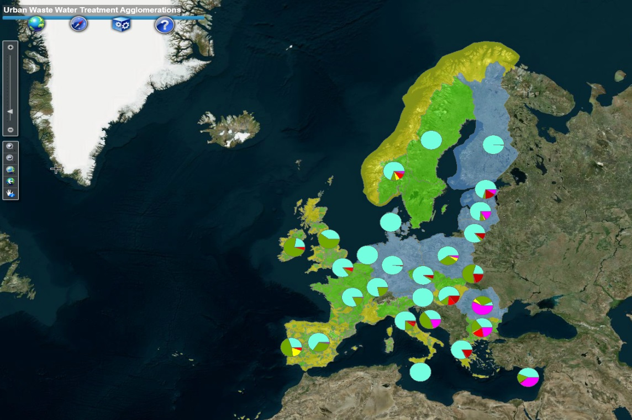
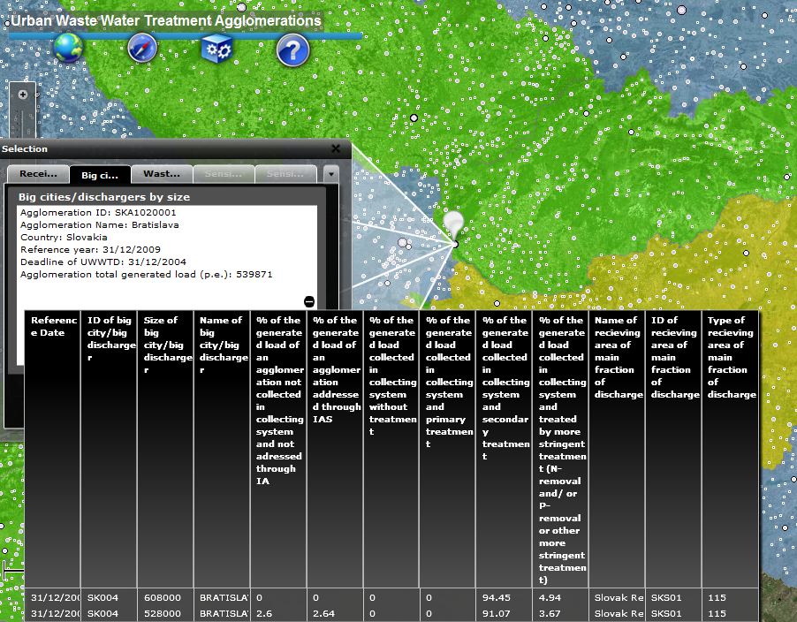
UWWTD map viewer-agglomerations
As currently displayed using FLEX
Overview of treatment pathways for about
26,000 agglomerations on a background of
designated sensitive areas
Link
Further details are available
in pop-up windows

Slide 4
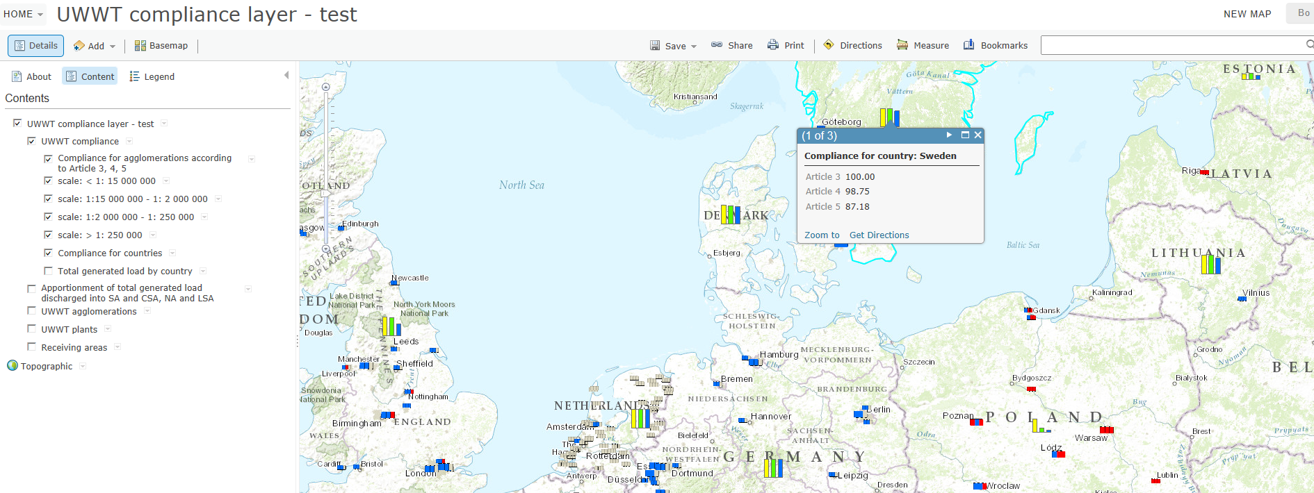
Migration of UWWTD map viewer
FLEX -> Arc GIS online in progress
Development and testing of new layer on compliance in progress

Slide 5
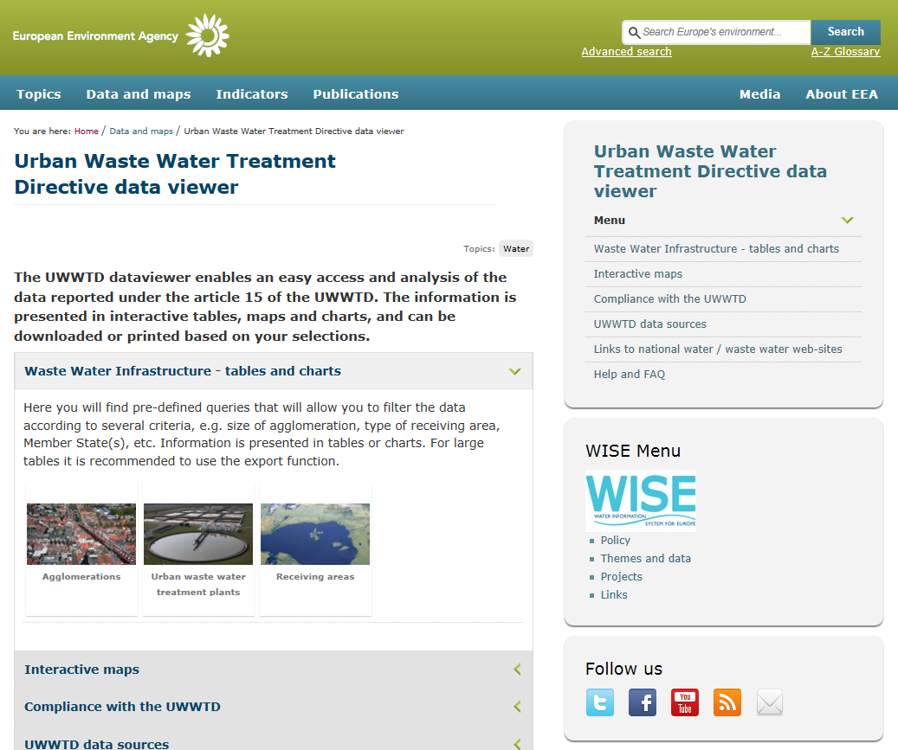
New UWWTD data viewer for pre-defined queries
Link

Slide 6
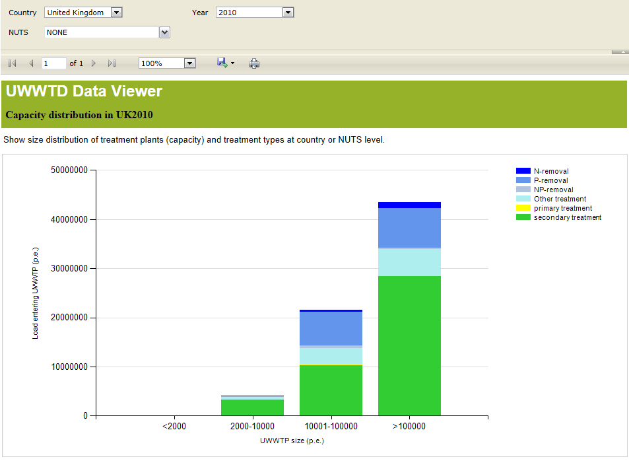
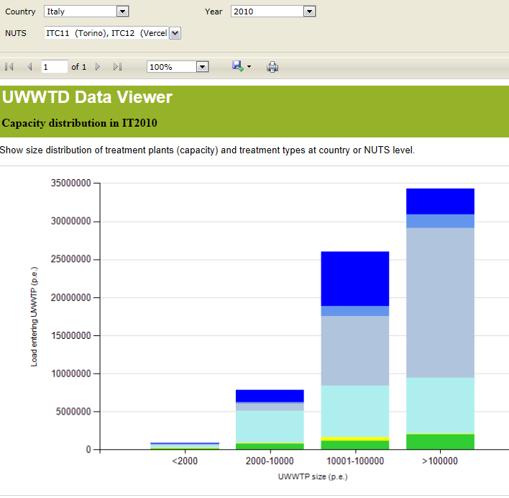
Siz
UWWTD data viewer
Link
Size distrubition and type of treatment for
entering p.e. load, 2010 situation
- here selected for UK and IT

Slide 7
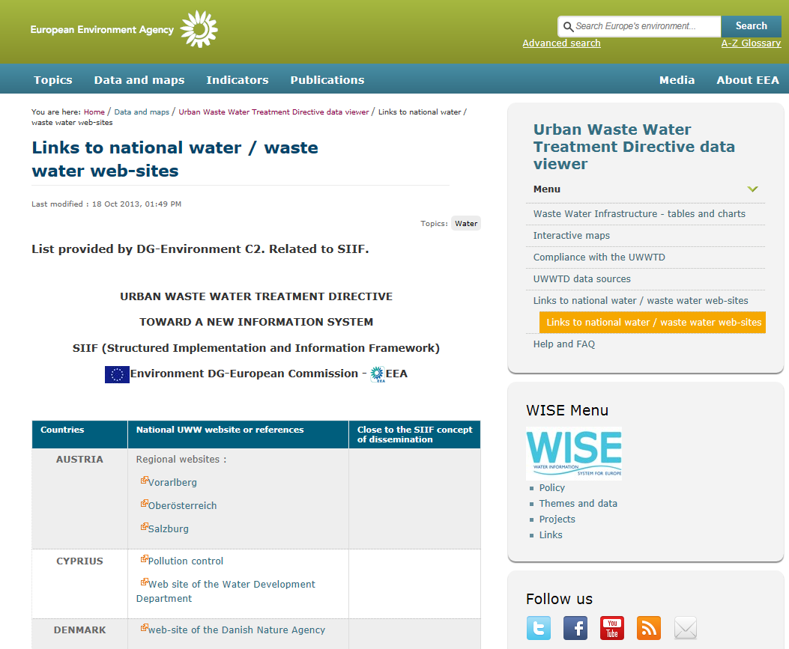
Overview list of national web-sites in UWWTD data viewer

Slide 8
WISE data maintanance - need for
- INSPIRE-compliant spatial datasets and
- tabular datasets fit for integrated asessments
Tabular datasets
Monitoring data, status info
– water quality
(ID, parameter values)
Monitoring data, status info
– water quantity
(ID, parameter values)
Reported data, - emissions, treatment type, compliance,..
(ID, parameter values)
Monitoring stations - quality
(ID, ID-WB, coordinates, stablie attributes)
Monitoring stations - quantiity
(ID, ID-WB, coordinates, stabile attributes)
Facilities (industries, treatment plants,..)
(ID, ID-WB, coordinates, stablie attributes)
WFD surface water bodies (WB)
Rivers, lakes, transitional, coastal
(ID, shapefiles, attributes)
WFD ground water bodies (WB)
(ID, shapefiles, attributes)
Udate frequency
WISE Main Rivers, Main Lakes
(ID, shapefiles, attributes)
Reference GIS datasets
WFD River Basin Districts
(ID, shapefiles, attributes)
NUTS1, NUTS2, NUTS3,..
(ID, shapefiles, attributes)
Country boarders
(shapefiles)
Coastline(s)
(shapefiles)
Spatial datasets
Notes:
Reference GIS datasets to be INSPIRE compliant and updated after certain period after any change made by MS
Tabular data regular reported by MS via current data flows – could potentially be developed into distributed system
This slide leads over to the role of Inspire in the whole game. It summarises the relationship and points out the main problem between tabular and georeference data sets in WISE

Slide 9
Perspective of Input/output versus geospatial/tabular (attribute) data
INPUT
OUTPUT
PRODUCTS
GEOSPATIAL
Arc GIS Online
Map viewer
and services
Visuali-sation
Down-loads
Common data structure
Central or
Decentral
SIIF - PILOT
Quality assurance; MS dialogue
TABULAR
(attribute)
Data viewer
Notes:
For Friday meeting to discuss if this perspective is correct and what does it mean??

Slide 10
Information for better implementation in the policy cycle
ENV
EEA
Implementation
assessment
- good status
Loads
Concentrations
Pressures
Impacts
Measures
Messages on the
problem
SOE information
- long term trends
soil, forest
land use,
Research info
Public
Outside EU 28
Compliance
- Exemption
Transposition
deadlines,
Infringement
procdures
DPSIR
Policy cycle
Information needed to interpret on wider ecosystem basis
‘Policy performance’
- Compliance indicators
‘Policy effectiveness’
- compliance indicators
Initial assessment and review of assessment
Notes:
E.g for SIIF UWWTD pilot compliance indicators are asked to be defined, which certainly is meant all implementation relevant compliance, not only the narrow understanding related to transposition
For WFD and marine assessments the implementation relevant information is what is expected in our status reports (like 2012 status report WFD art. 18) or marine baseline art. ??
Please compare the elements of initial assessment and review of assessment with figure 1 in the SIIF concept paper, if we agree that what is shown here is consistent, then the role distribution between EEA and Env is pretty clear
Behind this view on the policy cycle sits again the whole DPSIR with ist information needs on a certain aggregation level to perform a reasonable assessment.

Slide 11
Joint efforts with SIIF and WISE
- SIIF is implementing distributed/decentralised systems in WISE
SIIF
WISE
Common issues
- data models
Reporting / sharing
QA
dissemination
- legal cases
document management
- modelling
QC
indicators
‘Structured Implementation and
Information Framework ’
Policy performance’
- Compliance indicators
‘Water Information System for Europe’

Slide 12
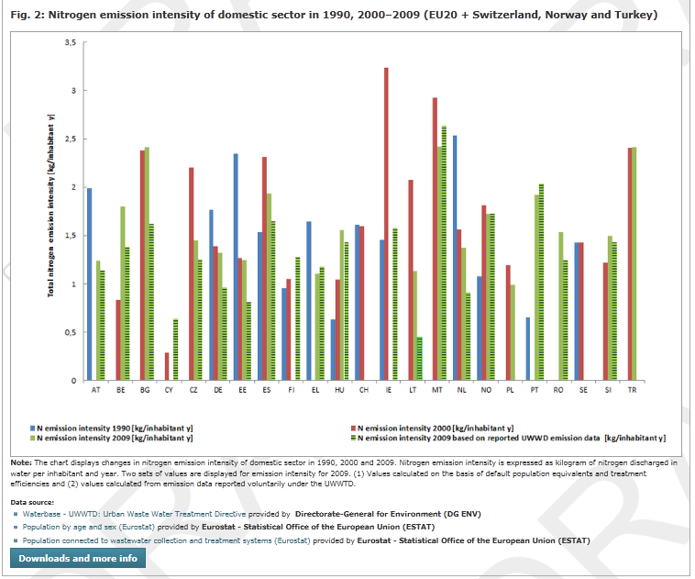
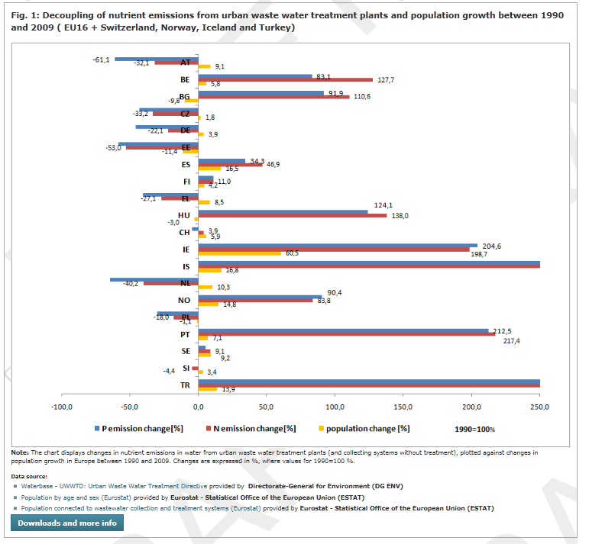
Additional data on actual emissions reported in UWWTD dataflow give added value for new water related resource efficiency indicators (WREIs)
Would be a pity if lost with SIIF approach
Link
(draft in Eionet consultation)

Slide 13
SIIF development
– potentials to gain and concerns to overcome with distributed / decentralised systems
Potentials
  Easier access to updated information
  Enabling automated procedures as input to EU-level compliance assessment
    Agglomerations – infrastructure in place
    Treatment plants – annual performance
Concerns
Keep QA/QC in advance of machine-to-machine exchanges
Depends on ”perfect” datasets
Not to lose current/update information on pressure to the environment

Slide 14
Thank you for your attention

