Slide 1


National Administration "Apele Române“
http://www.rowater.ro
European Commission
Directorate General for Environment
Unit C.2 - Marine Environment & Water Industry
Ministry of Environment, Waters and Forests
Structured Implementation and Information Framework for Urban Waste Water Treatment Directive (SIIF UWWTD)
ROMANIA
Corina Cosmina Boscornea
National Administration "Apele Române“
MEETING ON STRUCTURED IMPLEMENTATION AND INFORMATION FRAMEWORK (SIIF) FOR URBAN WASTE WATER TREATMENT DIRECTIVE (UWWTD)
9 November 2015, Brussels

Slide 2
National situation on collection
and dissemination of data
Responsibilities for urban wastewater data collection and dissemination
Competent authorities for European and national reporting (Ministry of Environment, Waters and Forests - MoE, National Administration “Romanian Waters” - NARW)
Local authorities (municipalities, County Council), Water services operators
Levels for data collection and dissemination
42 Water Management Systems
(county level)
11 Water Basin Administrations
(river basin level)
National Administration “Romanian Waters” Bucharest – headquarter (national level)

Slide 3
UWWTD informational flow for data collection -
national and European reporting purpose
EUROPEAN COMMISSSION
Ministry of Regional Development and Public Administrations
Ministry of Environment
Ministry of Agriculture and Rural Development
EIONET (EEA)
Other institutions (Institute for National Statistics, research institutes,consultants )
National level
National Administration “Romanian Waters””
Romanian Water Associations, public and private water services operators, other professional associations
River Basin level
Water Basin Administrations
Regional water operators, municipalities
County level
Regional water operators
Water Management Systems
County Council, city mayory
County Environmental Protection Agencies

Slide 4
National situation on collection
and dissemination of data
Database on status of implementation of art. 15 & 17 of UWWTD:
Reporting by public utility service providers and municipalities to Water Management Systems & Water Basin Administrations based on specific questionnaire – county level
Reporting by Water Basin Administrations to the NARW (annually by 31th March for 2 previous year) into specific format according to the art. 15 & 17 requirements - river basin level
Reporting by NARW to MoE into specific format according to the art. 15&17 requirements – national level
EU reporting by MoE to European Comission (official letter) and NARW to the EIONET (Reportnet CD of EEA) – European level
Romania does not currently have a specific integrated informational database system for UWWTD, but it use some specific water information from own internal informational system – Romanian Water Information Management System (WIMS)
Romania use also other databases relevant for UWWTD implementation

Slide 5
Current use of data
(only reporting or other national uses)
Fulfil certain requirements for EU reporting to:
European Commission (reporting under Art. 15 &17of UWWTD)
Other Directives (WFD, MSFD, etc.)
Eurostat / OECD /UNECE
EEA
International Commission for Protection of the Danube River (ICPDR)
Black Sea Convention
Internal use
emission controls
permit process
preparation of information for interested or general public
distributional databases on emissions (Industrial Facilities and UWWTPs) for internal users and MoE
Public access
NARW’ web-page (www.rowater.ro)
MoE’ web-page (www.mmediu.ro)
Article, papers, summary of situations

Slide 6
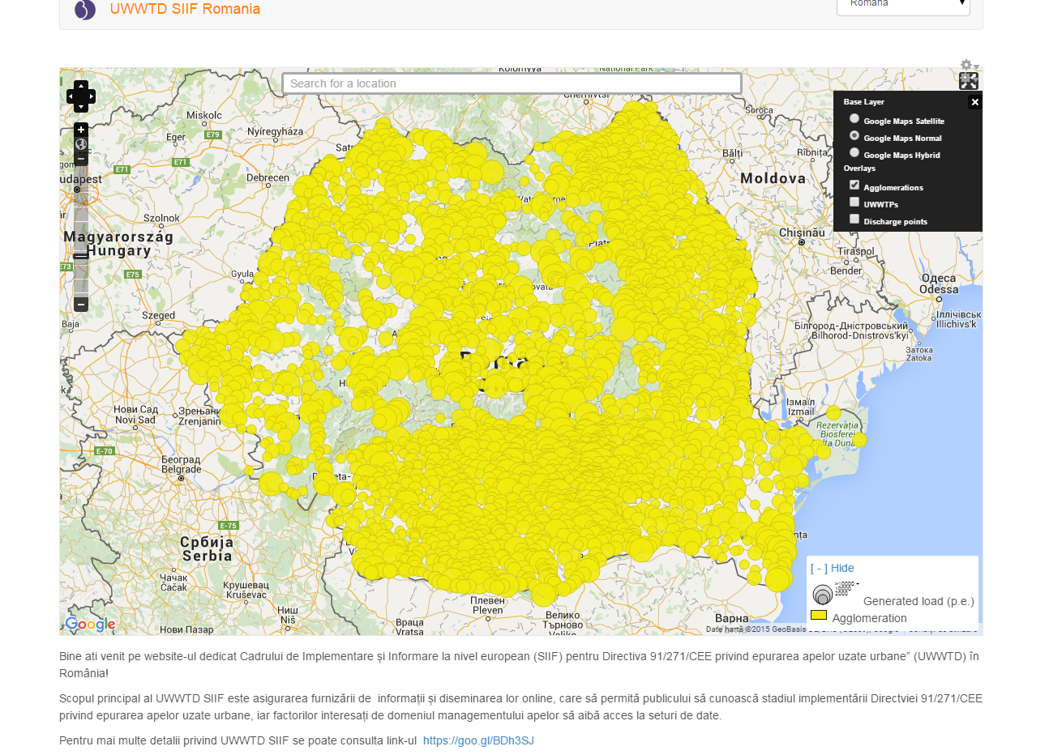
What is under development at national level to improve the situation?
http://uwwtd.rowater.ro:8080/uwwtd_ro

Slide 7
What is under development at national level to improve the situation?
NARW created own national webpage - UWWTD generic SIIF node for Romania (http://uwwtd.rowater.ro:8080/uwwtd_ro)
Only mandatory data and information about UWWTD implementation in Romania will be provided to the public
Public information about UWWTD aspects will be displayed in a friendly way using dynamic maps, tables and charts
Possibility to download datasets in various formats will be offered for general public and national and European water stakeholders
Update, complete an maintain the UWWTD SIIF generic website for Romania (NARW level) - translation in national language, feeding of text sections and relevant resources and links, connection with other potential references and links

Slide 8
What is under development at national level to improve the situation?
Eurostat Waste Water Tables has to be done for the 10th reporting (improvements)
update information on implementation plan of the UWWTD according the art. 17 requirements and format required by New Decision 2014/431/EU (detailed information on works status, deadlines, cost, financing sources, responsibilities, gaps and delays, etc.)
add new parameters for national use and interconnexion of data with INSPIRE Directive (INSPIRE Agglomeration table, INSPIRE UWWTP table, INSPIRE discharge point table) - the parameters should analyzed as long as the information at the national level on INSPIRE data (III.6 Public utility services and other public services) are going to be designed
add new optional parameters for national use and interconnexion of data - will be a challenge that some of proposed tables to be tested under the new phase of the SIIF depend on Romanian data availability (results of the 2 stakeholders consultation meetings in June and September 2015 – starting with agglomerations with more than 100,000 p.e. for some new specific tables for municipality, water utility, storage tanks)

Slide 9
Challenges
Administrative structure and procedures – replace the existing RO data collecting system (partially assure by paper questionnaire) with tool that SIIF pilot project would provide to aid the data collection process at national level (forms accessible from the web portal where data could be submitted or online fulfill by the water services operators)
Time for processing & validation data – need QA/QC automatic process to be included in the generic specific SIIF website
Difficulties to develop national INSPIRE compliant data model - Romania just started to implement INSPIRE rules on water services in order to give access to the environmental information
Lack of financial resources to maintain an information system in which national sites will dynamically be connected to EU level

Slide 10
SIIF UWWTD Benefits
Streamlining of reporting:
avoiding double reporting of the same data by different reporters
avoiding double reporting of the same data to different institutions
Better identification of the UWWTD progress of compliance
Better identification of the reasons for delays for UWWTD implementation
Control over reporting of performance of public service
Improvement of data collection at national level and improvement of collection tool
Connection of relevant databases: database on emissions as well as other relevant databases (i.e. E-PRTR)
Include of QA/QC controls
Facilitate data reports (geographical, statistical analysis, reports, etc.)
Improvement of public access to information (easier access to raw and aggregated information)
Share the improvements of the SIIF platform with other MS

Slide 11
What is expected from the Commission as regards future SIIF development and reporting 2016-2021?
1. Specific tables, specific layers to be added in the map viewer
Tool provided to aid the data collection process at national level
Need QA/QC automatic process to be included in the generic specific SIIF website
Possibility to operate statistics
Possibility to generate online reports
New possibilities to include dynamic maps
To export datasets in various formats for own future uses
Additional dataset could be added and displayed on the several maps (i.e art. 17 information) depending on data availability
2. To include the automatic generation of compliance parameters, automatic export of tables, automatic generation of Article 17 table with not compliant situation
3. Proposed content of the new SIIF/reporting contract :
one or two days meeting in order to have direct exchanges at national level to prepare a correct dataset by the end of June 2016
online assistance to the use of the generic waste water website with the new functionalities with RO dataset by the end of June 2016
carry out the final assessment of the dataset after the reporting deadline in June 2016
Notes:
x

Slide 12



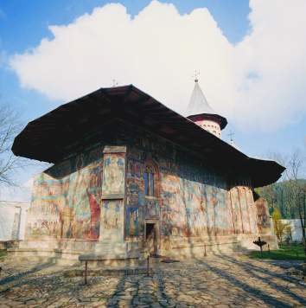
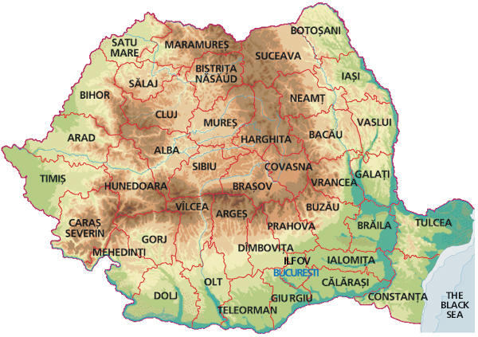

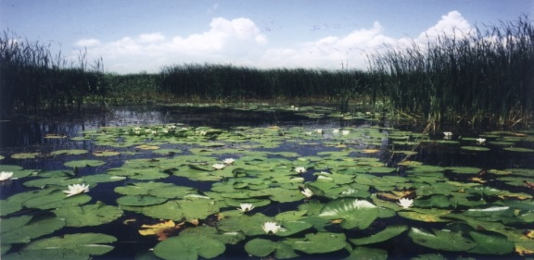
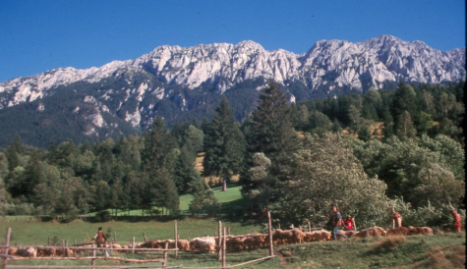
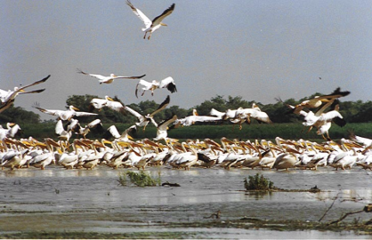
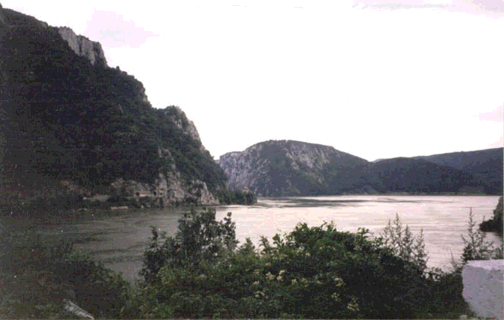
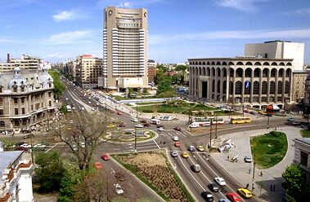

THANK YOU !
www.rowater.ro
www.mmediu.ro
R O M A N I A

