Slide 1

”A bit of IT ...”
Where we are and which choices we have
Stefan Jensen, Head of group, SEIS and SDI
UWTTD meeting 24.10.2013
Notes:
<number>

Slide 2
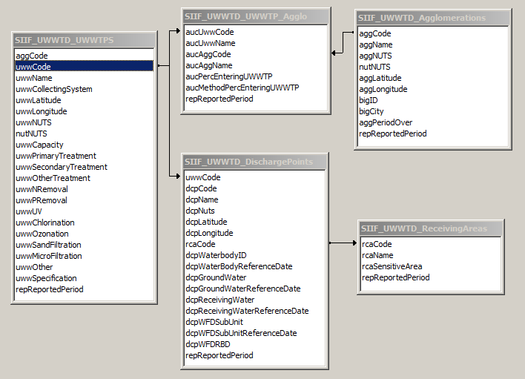
Consolidating the data models
Tabular data:
thematic attributes,
compliance data
Reference data / layers:
Spatial data – INSPIRE conformance
- UWWT plants,
discharge points
- agglomerations
- sensitive areas
Example reference data:
Notes:
<number>

Slide 3
Data structure and IT system
Guiding principles:
Flexibility, decentral maintenance, more up-to-date
data and information
Implemented through
:
Common structure to use for integrated work in WISE
> reference data, INSPIRE data models
Use of standardised, distributed services
> INSPIRE network services (WMS, WFS)
Notes:
<number>

Slide 4
SIIF using distributed services – the simple picture
national SIIF nodes
holds relationship between National WFS services and EU base layers / EU SIIF node
WFS
EU SIIF node
WFS
Broker / Harvester
UWWTD
Viewer
integration view
WFS
WMS
WFS
WFS
WFS
REST WS
Discomap
REST services
reference maps

Slide 5
SIIF using distributed services – the experiment part 1
national SIIF nodes
holds relationship between National WFS services and EU base layers / EU SIIF node
WFS
EU SIIF node
Broker / Harvester
UWWTD
Viewer
integration view
WFS
WFS
REST WS
Discomap
REST services
reference maps

Slide 6
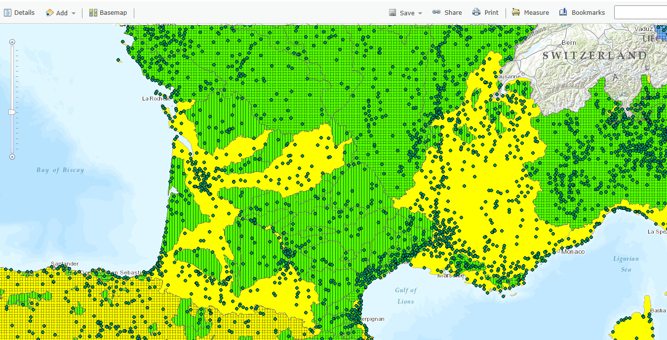
The European SIIF node – WFS/WMS „experiment“ – reference data
EEA starts providing INSPIRE conformant network services
http://inspire.discomap.eea.europa.eu/arcgis/rest/services
Notes:
<number>

Slide 7
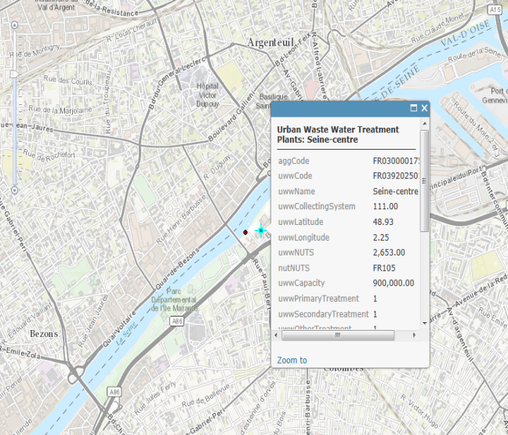
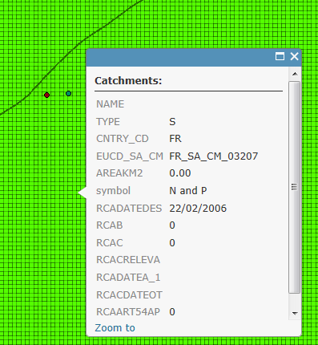
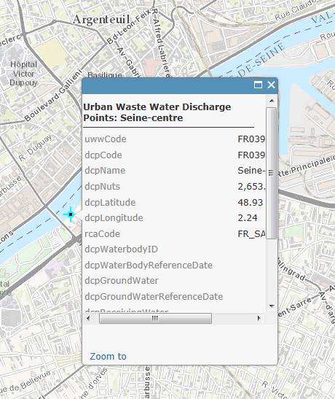
The European SIIF node – WFS/WMS „experiment“ – reference data
UWWT
plant
info
related catchment
Info
UWWT
discharge point
info
... and more
Notes:
<number>

Slide 8
SIIF using distributed services – the experiment part 2
national SIIF nodes
holds relationship between National WFS services and EU base layers / EU SIIF node
WFS
FR data
EU SIIF node
WFS
Broker / Harvester
HANDCODED
UWWTD
Viewer
integration view
WFS
WMS
WFS
Discomap
REST services
reference maps

Slide 9
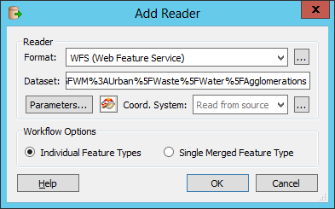
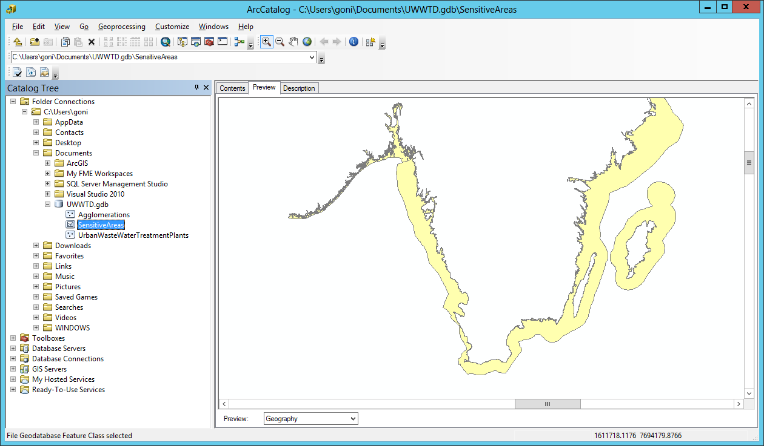
The National SIIF node - WFS „experiment“ – FR data
1: We choose the reader format ”WFS (Web Feature Service)”.
2: Next, we choose the dataset. In this case: ”http://inspire.discomap.eea.europa.eu:80/arcgis/services/SIIF_UWWTD_INSPIRE_WM/MapServer/WFSServe”
After that, we click on ”Parameters...” button and a large form appears. On this form we have to choose the Feature type.
Next we choose the dataset. The easiest way to do is to introduce the complete url
with the requested feature in the WFS.
For example: “http://www.uwwtd.oieau.fr:80/services/wfs?SERVICE=WFS&VERSION=1%2E1%2E0&REQUEST=DescribeFeatureType&TYPENAME=UWWTD%3AUWWTD%5FUrbanWasteWaterTreatmentPlant
3.- 6. .... Special configurations
7: One result
....
As of 23.10.2013 - 15:00 - for trial
WFS GetCapabilities
http://www.uwwtd.oieau.fr/services/wfs/?service=WFS&version=1.1.0&request=GetCapabilities
Notes:
<number>

Slide 10
Issues encountered
Distinction compliance information / thematic data /
(spatial) reference data needs more clarification
Availablility of web services not a given
> sustainable effort for national SIIF node?
Configuration of WFS needs som expertise
> extra guidance needed
Cost of maintaining the system – who covers what?
Notes:
<number>

Slide 11
Scenario 1 (full WFS/WMS based)
National SIIF node provides WFS in agreed format – covering all spatial data –
both, thematic and INSPIRE data elements in the following alternative form
complete
(b) updates only
EU SIIF nodes loads full data into harvester/broker and updates regularily
Reference data sets in EU SIIF node are replaced by National SIIF node data
(„cookie approach“)
Notes:
<number>

Slide 12
Scenario 2 (hybrid)
National SIIF node provides WFS in agreed format – covering only often changing
tabular data and or additional compliance data – link through spatial object/ID
National SIIF node provides updates to their reference data manually to Reportnet
EU SIIF node updates EU reference data sets in regular intervals
EU SIIF nodes loads this partial data into harvester/broker and updates regularily
Reference data sets in EU SIIF node are complemented by National SIIF node data
(„add-on approach“)
GREEN = current approach
Notes:
<number>

Slide 13
Scenario 3 (current – extended Reportnet )
National node provides all data manually to Reportnet
National node informs / Reportnet checks availability of new data
EU node updates member state data and EU reference data sets
in regular intervals
GREEN = current approach
BLUE – Reportnet development scenario
Notes:
<number>

Slide 14
Way forward
Conclude on concept validation
review lessons learnt from experiments (”mock-ups”)
> evt. conduct more in-depth experiments
Move to first implementation steps
> provide full data modelling (thematic vs. INSPIRE)
> build functional system prototype incl. pilot countries
Notes:
<number>

Slide 15

Thank you for your attention !
Notes:
<number>

