Slide 1
ESSnet(s)
Big Data I + II
Item 8 of the agenda
Joint DIME-ITDG Plenary
Luxembourg, 24 Feb 2015

Slide 2
Request for Action
The DIME-ITDG Plenary is requested to:
To issue its opinion towards the ESSC on the 2 ESSnets and
whether the 1st ESSnet can be included in the list of ESSnet projects 2016

Slide 3
Current Situation and Mandate for Change
Endorsement of the Big Data Action Plan and Roadmap 1.0 (BDAR) by the ESSC in Sep 2014
ESS TF Big Data to coordinate implementation of the BDAR
Integration of BDAR into ESS Vision Portfolio
The current business case implements a part of the BDAR, namely the ESS pilot projects on Big Data

Slide 4
Scope
The ESSnets mainly covers
  chapter 5.4, Pilot actions and
  chapter 6, "Pilot Projects" of the BDAR
  Pilots should contribute to overall objective of preparing the ESS for integration of big data sources and methods into production of official statistics
  Hands on experience through execution of the pilots
  Contribution to relevant horizontal topics
Phased approach to pilot execution
  1st ESSnet for 1st wave of pilots (2016-17)
  2nd ESSnet for 2nd wave of pilots (2018-19)

Slide 5
Aims and Objectives
Execution of pilots for generating statistics from big data sources at ESS level
  European dimension should be considered
  Identification and analysis of output portfolio of big data sources
  Access to big data sources
    Identification and preparation of conditions for sustainable access for the ESS
  Identification and definition of skills and competences

Slide 6
Aims and Objectives
Execution of pilots for generating statistics from big data sources at ESS level
  Exchange of information between stakeholders
    Statistical System
    Data producers
    Scientific Community
  Further development / review of methodological and quality frameworks
  Identification, definition and implementation of IT infrastructures for pilots
  Outline IT infrastructure for possible implementation

Slide 7
General Approach (1st wave)
Framework Partnership Agreement or Multi-beneficiary Grant Agreement
  Duration of 2 years for first phase of pilots
In case of FPA: Specific grant agreement
  To start work in 2016
  Duration between 1 and 2 years

Slide 8
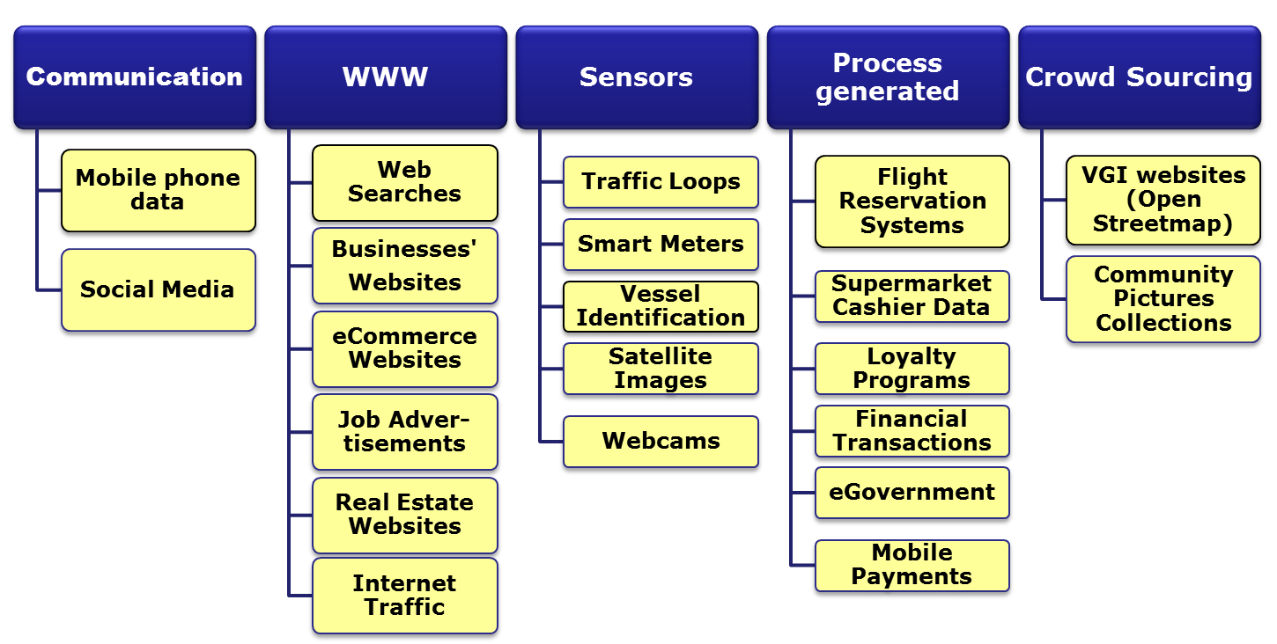
Pilots

Slide 9
Pilots - Criteria for Selection
Data source
  Access to data
  European dimension
  Sustainability of the source
  Mix of origin
Potential statistical products
  Relevance at different levels (European, national, regional)
  Mix of output domains and product types
  Supplementing or replacing existing output vs. creating new output
  Expected quality of output
Production process (from source acquisition to dissemination)
  Privacy / Confidentiality
  Methodology
  IT infrastructure
  Legislation

Slide 10
ESSnet – Expected Results
Reports
  Evaluation of big data sources and definition of possible statistical products from examined big data sources
  Business architecture suitable for big data processing
  Contribution to
    Methodological framework
    Quality framework
    Metadata framework
    IT infrastructure
    Protection of privacy and confidentiality and other legal issues
  Inventory, requirements, definition, and specification of future big data integration

Slide 11
ESSnet – Expected results
What is not included from the BDAR?
  Integration of Official Statistics in governmental big data strategies at national level across the ESS
  Integration of Data Science in official statistics education
  Elaboration and provision of trainings
  Adaptation of the European and national legislation to achieve compatibility with the ethical use of big data in official statistics,
  Establishment of general partnerships with data providers and other stakeholders at the level of the ESS,
  Integration of big data sources in the official statistics production across the ESS.

Slide 12
Request for Action
The DIME-ITDG Plenary is requested to:
To issue its opinion towards the ESSC on the 2 ESSnets and
whether the 1st ESSnet can be included in the list of ESSnet projects 2016

Slide 13
Thank you for your attention

