Slide 1
Standardisation
DIME-ITDG 2015 Item 6

Slide 2
Why standardisation?
Standards are a common asset to the ESS:
HLG initiatives (GSBPM, GSIM, CSPA)
Seasonal adjustment guidelines
Classifications (E-COICOP, NACE)
SDMX
The ESS establishes standards in a varied and unclear way (stove pipes) and has no overview over existing standards and ongoing standardisation activities

Slide 3
Why standardisation?
Well directly from Vision 2020:
Improvement of the efficiency and robustness of statistical processes through systematic collaboration within the ESS requires agreed standards
Standards support the sharing of knowledge, experiences and methodologies and the sharing of tools, data, services and resources
Implementation of standard methods and tools also improves the comparability of outputs

Slide 4
Context
ESSC request to DIME in September 2013 to follow-up the recommendations of the Sponsorship on Standardisation
  Definition, inventory, standardisation process, architectural framework, impact assessment, environment and communication
TF on Standardisation
ESSnet on Standardisation
Report back to ESSC

Slide 5
What are we seeking?
Clear guidance on:
The Standardisation Process
The Strategic Governance
The Operational Governance

Slide 6
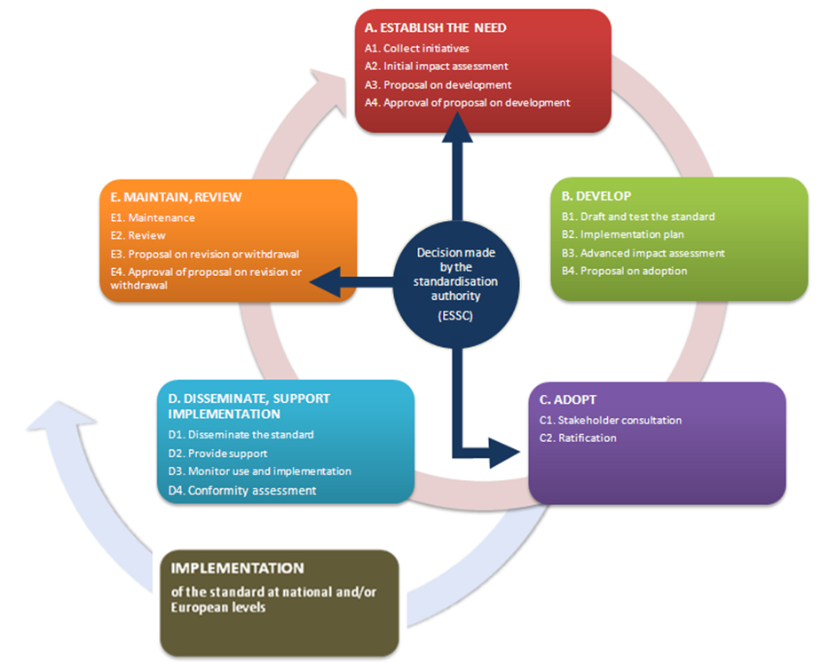
Standardisation process

Slide 7
Five Principles of Standardisation
Consensus
Transparency and openness
Balance
  between all countries
Due process
  Consider all stakeholders
Proportionality
  Lean
  Reasonable cost
  Proportional to benefits

Slide 8
Governance
ESSC = standardisation authority
DIME = mandated by the ESSC to ensure the strategic coordination of standardisation activities
Expert Group on Standardisation = preparing input to and supporting the DIME
Centre of Excellence = operational tasks related to the standardisation process

Slide 9
Strategic tasks - DIME
Setting Direction for portfolio of standardisation activities
Approving guidance documents and templates
Overseeing operational tasks on standardisation
Giving an opinion (standardisation perspective) on potential standards before adoption by ESSC; preparing decisions for the ESSC
Ensure alignement with strategic developments (e.g. implementation of the ESS Vision 2020)
Contributing to the communication by promoting and encouraging the use of standards

Slide 10
Operational tasks – EG / CoE
Develop guidance documents, templates, glossaries
Offer guidance to proposers, developers and implementers of standards
Review proposed standards
Maintain the catalogue of standards
Prepare reports for the DIME
Disseminate, actively promote and oversee the implementation of standards

Slide 11
Next steps
Opinion of DIME/ITDG on standardisation process, governance and practical handling of operational tasks with clear link to Vision. Accept work of the TF and formally close – Feb 2015
Submission of the proposal on standardisation process and governance to the ESSC – May 2015
Finalisation of governance – DIME/ITDG SG
– Jun 2015
Operational tasks development – EG – prioritisation and first actions (catalogue of standards and overview on-going standardisation activities)
- 2015

Slide 12
Thank you for your attention!

